Slide 1

#EmpoweringMEandYou
Don’t Fall Into the Thinking Trap
University of Maine Cooperative Extension 4-H Healthy Living Team 2020
Kalayaan C., Nathan D., Maddie G., Jordyn M., Sam P., Grace T.
Advisor: Sara Conant, 4-H Community Education Asst., sara.conant@maine.edu, 207-781-6099

Slide 2

What are Thinking Traps/Cognitive Distortions?
Habitual negative thought patterns
Coping mechanism that develops when someone faces severe or prolonged adverse/negative experiences
Notes:
Many people experience these cognitive distortions from time to time, but if allowed to continue unchecked they could lead to further mental health disturbances such as anxiety or depression.
The more severe or prolonged the adverse event is, the more likely it is that one or more cognitive distortions will develop.
In the 1960’s, physiatrist Aaron Beck pioneered the research on cognitive distortions and created Cognitive Behavioral Therapy (CBT) to combat it.
One of Beck’s colleagues, David Burns, is considered a foremost expert in making cognitive distortions easy for the public to understand and overcome. In his book The Feeling Good Handbook he outlines ten common thinking traps/cognitive distortions, as well as ways to untwist the thinking.
We will discuss five of these ten cognitive distortions.

Slide 3

Personalization
Blaming or holding yourself responsible for something that wasn’t entirely your fault or in your control
Can lead to feelings of guilt, shame, & inadequacy

Slide 4

Jumping to Conclusions
You negatively interpret things without facts to support the conclusion
  Mind-Reading: Without supporting facts or digging deeper you assume others are thinking negatively of you
  Fortune-Telling: You predict negative future outcomes as if you know that they will certainly be true

Slide 5

All or Nothing
You look at things in absolute black and white categories
  You are either a success or a failure. Your performance was totally good or totally bad.
  I always fail when I try to do something new; I fail at everything I try

Slide 6
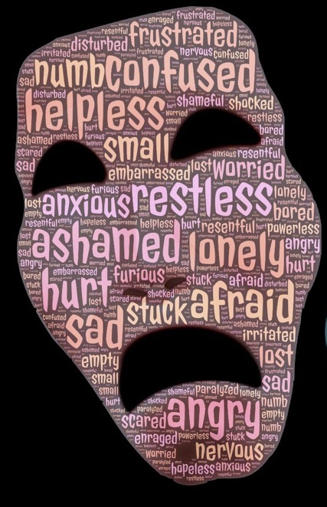
Labeling
An extreme form of All or Nothing
You identify yourself by your shortcomings or failures.
  Instead of saying “I failed at this one task” you attach an extreme negative label to yourself such as “I am a complete failure”
Labeling implies something is wrong with yours or someone else’s character or essence rather than their thinking or behavior
Notes:
Labeling tends to imply that something is wrong with your true character or essence rather than just your thinking or behavior.
You can also label others in your thoughts which could be damaging to your relationship with them and limit forward movement in the relationship.

Slide 7
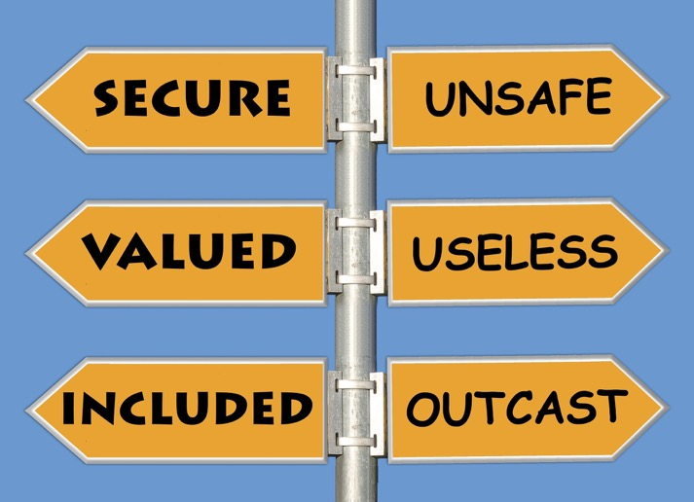
Discounting the Positives
You reject positive experiences by insisting they don’t count
Even if you do a good job you tell yourself that it wasn’t good enough or that anyone could have done it just as good

Slide 8
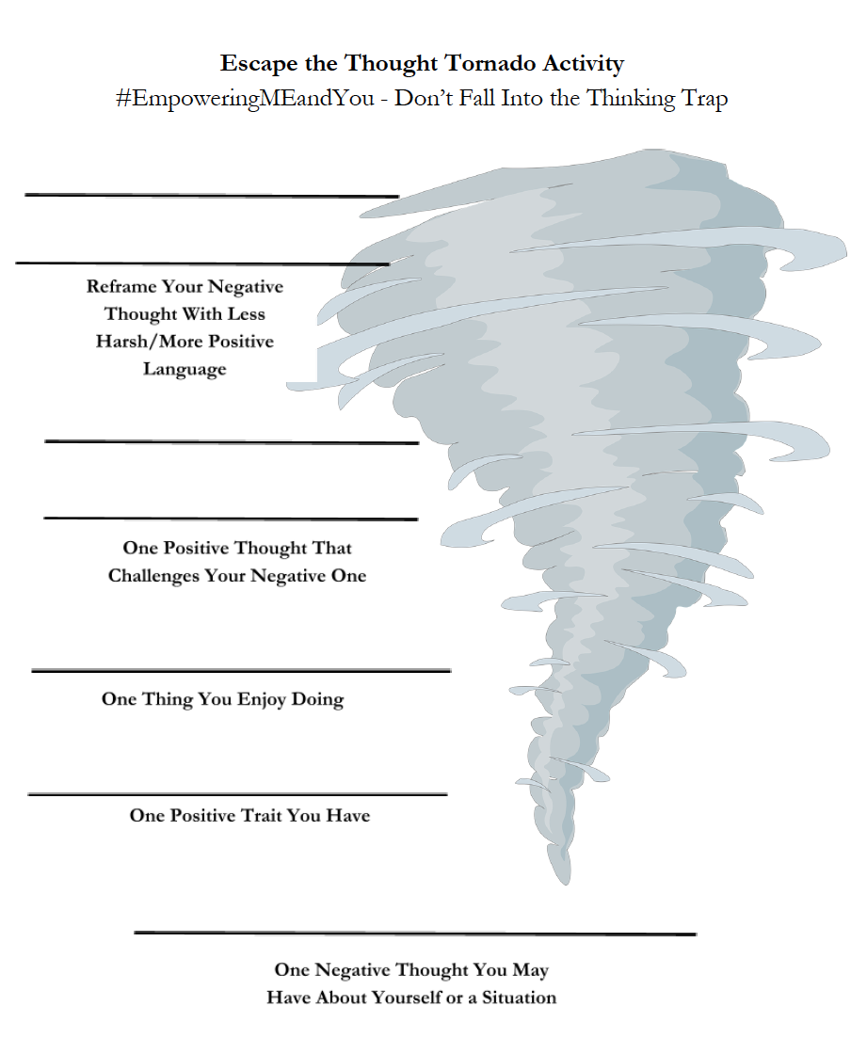
Escaping the Thought Tornado
I am not yet as confident as I would like to be when in a group setting. There may be others feeling the same way as me too.
I’ve been told I have nice laugh and a good sense of humor.
I enjoy being outdoors with my close friends.
I have pretty eyes.
I don’t feel confident in myself when I’m in a group, everyone is better looking, funnier, or more personable than I am.
Notes:
This is an example of examining the evidence.
Examining the evidence is a way for you to challenge your negative thoughts by looking further into the statement and trying to find examples of things that prove your negative thought to be a distorted view of reality.
By challenging the validity of these negative thoughts one can start to bring themselves out of a negative swirl.
There are a variety of ways to examine the evidence, these prompts are just one example of a way to bring oneself up out of the spiral.
Ideally we would want the reframing to be even more positive than it is but complete positivity and a total reframe of negative thoughts does not happen overnight. Even a small change in the right direction should be celebrated!

Slide 9
Climbing out of the Trap
Identify the Distortion
  Write down your negative thoughts to help you determine which thinking trap you’re falling into
Define Terms
  When you label yourself as something, ask yourself what that term actually means - really flesh out the definition
Thinking in Shades of Gray
  Evaluate your problem on a range of 0 to 100 rather than 0 OR 100.
The Survey Method
  Ask questions of others whom you trust to test your assumptions
Notes:
Identify the Distortion
This makes it easier to identify the problem in a realistic and more positive way.
The more you do this the easier it will be to catch and identify the distortion almost automatically before needing to write it down.
Define Terms
If you call yourself a fool, ask yourself what is a fool, really dive deep into the definition of that
Do you really feel that what you did or thought is what you labeled it, or is it possible you were a bit harsh?
The more you begin to define these terms and question your thoughts the more you will recognize and eventually be able to stop or counteract the negativity.
Thinking in Shades of Gray
Look at your problems as being on a continuous spectrum rather than a weighted balance scale or a see-saw where things are all one or the other
Use past perspectives to help you put this situation into perspective rather than having it all out there on its own as a daunting situation. Dropping your ice cream on the ground on a hot summer’s day can seem like just the worst thing and ruin the whole day, but when you put it into perspective and compare all the other awesome things you did during the day you can see that dropping your ice cream was just one bad thing not a whole day ruiner.
The Survey Method
If you think being afraid to walk into a crowded classroom with strangers on the first day of class is abnormal or weird, ask some trusted friends, advisors, parents, a counselor, etc. if they get nervous meeting strangers, or being in a crowded place and see what they say. You may be surprised how many people share the same fear as you or how many challenge it and help you to put it in perspective.

Slide 10
Resources
National Institute for Mental Health: Factual information about a variety of mental health topics, including stress; www.nimh.nih.gov/health/index.shtml
Teen Line: Talk, Text, Chat with trained teens about mental health support. Available 6:00 - 10:00PM PST. If these times do not work for you, they also are available by email
teenlineonline.org or 1-800-852-8336 or text "TEEN" to 839863
NAMI Maine Teen Text Line: Open 12pm - 10pm. This peer support text line is for youth 14-20 years old and staffed by individuals under 23 years of age. Text them at (207) 515 - 8398,
National Suicide Prevention Lifeline: If you or someone you know is struggling with their mental health. Available 24/7 to call or chat online. Free & confidential
suicidepreventionlifeline.org/talk-to-someone-now/ or 1-800-273-8255

