Slide 1

#EmpoweringMEandYou
Stress Less
Designed by the University of Maine Cooperative Extension 4-H Healthy Living Team 2019
Nimo A., Maddie G., Jordyn M., Sam P.
Presented by: Kalayaan C., Nathan D., Maddie G., Jordyn M., Sam P., Grace T.
Advisor: Sara Conant, 4-H Community Education Asst., sara.conant@maine.edu, 207-781-6099

Slide 2

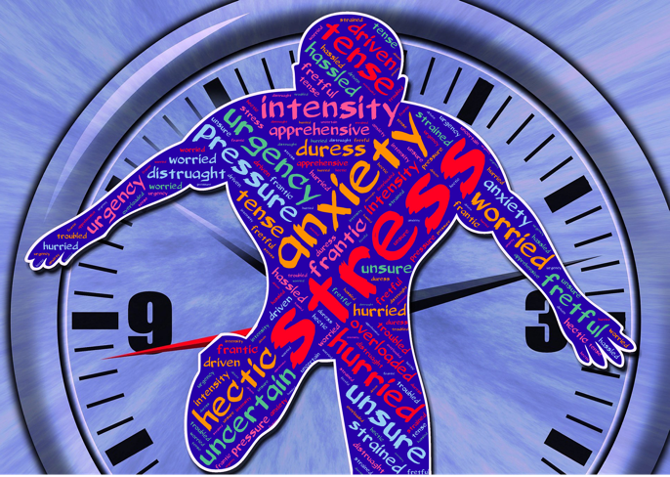
What is Stress?
A normal reaction the body has in response to any change that requires a response or adjustment
Short or long-term
Caused by positive or negative change

Slide 3
Some Effects of Stress
Headaches
Chest Pain
Fatigue
Muscle Tension
Upset Stomach
Lack of Motivation or Focus
Irritability or Anger
Sleep Disruptions/Restlessness
Sadness or Depression
Over or Under Eating
Higher rate of risky behavior
Long Term
Anxiety
Depression
High Blood Pressure
Heart Disease
Diabetes
Weakened Immune System

Slide 4

Coping Strategies - Mindful Breathing
My Life Stop, Breathe & Think Mindful Breathing Exercise on YouTube - Here
OR
Download My Life App - Here

Slide 5




Free Apps to Help Cope with the Effects of Stress
My Life - a variety of sessions for sleep, focus, anxiety, stress and more that vary in length.
Oak - guided and unguided meditation as well as sleep sounds and breathing exercises. Daily meditation reminders
Shine Self-Care & Meditation - daily positive text messages. Lots of topics including 5 minute meditations and affirmations.
Happify - activities and games to help reduce stress, overcome negative thoughts, and build greater resilience to improve emotional well-being.

Slide 6
Additional Ways to Cope with Stress
Listening to music
Going for a walk/driving around
Know your stressors and avoid those that are avoidable
Organizing (to do lists, break tasks into smaller pieces, cleaning room, planning ahead/checking calendar)
Exercising
Doing your favorite hobby/something that makes you happy
Journaling/Write down what you’re stressed about/Drawing/Coloring
Talking with a friend/trusted advisor
Seeking appropriate professional help (ex. Counselor)
Watching a funny/positive show
Drinking water & eating a healthy diet
Volunteering or helping others

Slide 7
Reframing Negative Self Talk
Re-write the following to reframe the situation in a positive way
“Ugh, I shouldn’t have answered that question at the meeting today. I got it wrong and now everyone must think I’m so dumb!”
Reframe: “That was really brave of me to answer that question today even though I wasn’t sure I was right. Sammy answered the next question wrong too and I didn’t think they were dumb, I was glad they tried too.”
“I can’t hang out with anyone ever, I have so much to finish before I graduate, being a Senior is not as awesome as they said it would be!”
Reframe: “Being a Senior is a lot more time consuming than anyone ever said but I know I only have a month until graduation and then I get a few weeks off to catch up with friends.”

Slide 8
Handling the Negative Talk/Stress of Others
Let it Go: It’s important to be supportive of friends and family but sometimes you just can’t help them, don’t worry about what you can’t change.
Don’t Make it Personal: It’s easy to get wrapped up in helping others but don’t take someone else’s stress on as your own.
Share: Let the person know some positive ways they could solve their problem or cope with the stress. Also share with them when their negative self talk or stress becomes too overwhelming for you.
Take a Break: It’s okay to give yourself some space from others who are negative or stressed.

Slide 9
Resources for More Information
National Institute for Mental Health: Factual information about a variety of mental health topics, including stress; www.nimh.nih.gov/health/index.shtml
Teen Line: Talk, Text, Chat with trained teens about mental health support. Available 6:00 - 10:00PM PST. If these times do not work for you, they also are available by email
teenlineonline.org or 1-800-852-8336 or text "TEEN" to 839863
National Suicide Prevention Lifeline: If you or someone you know is struggling with their mental health. Available 24/7 to call or chat online. Free & confidential
suicidepreventionlifeline.org/talk-to-someone-now/ or 1-800-273-8255

