Slide 1
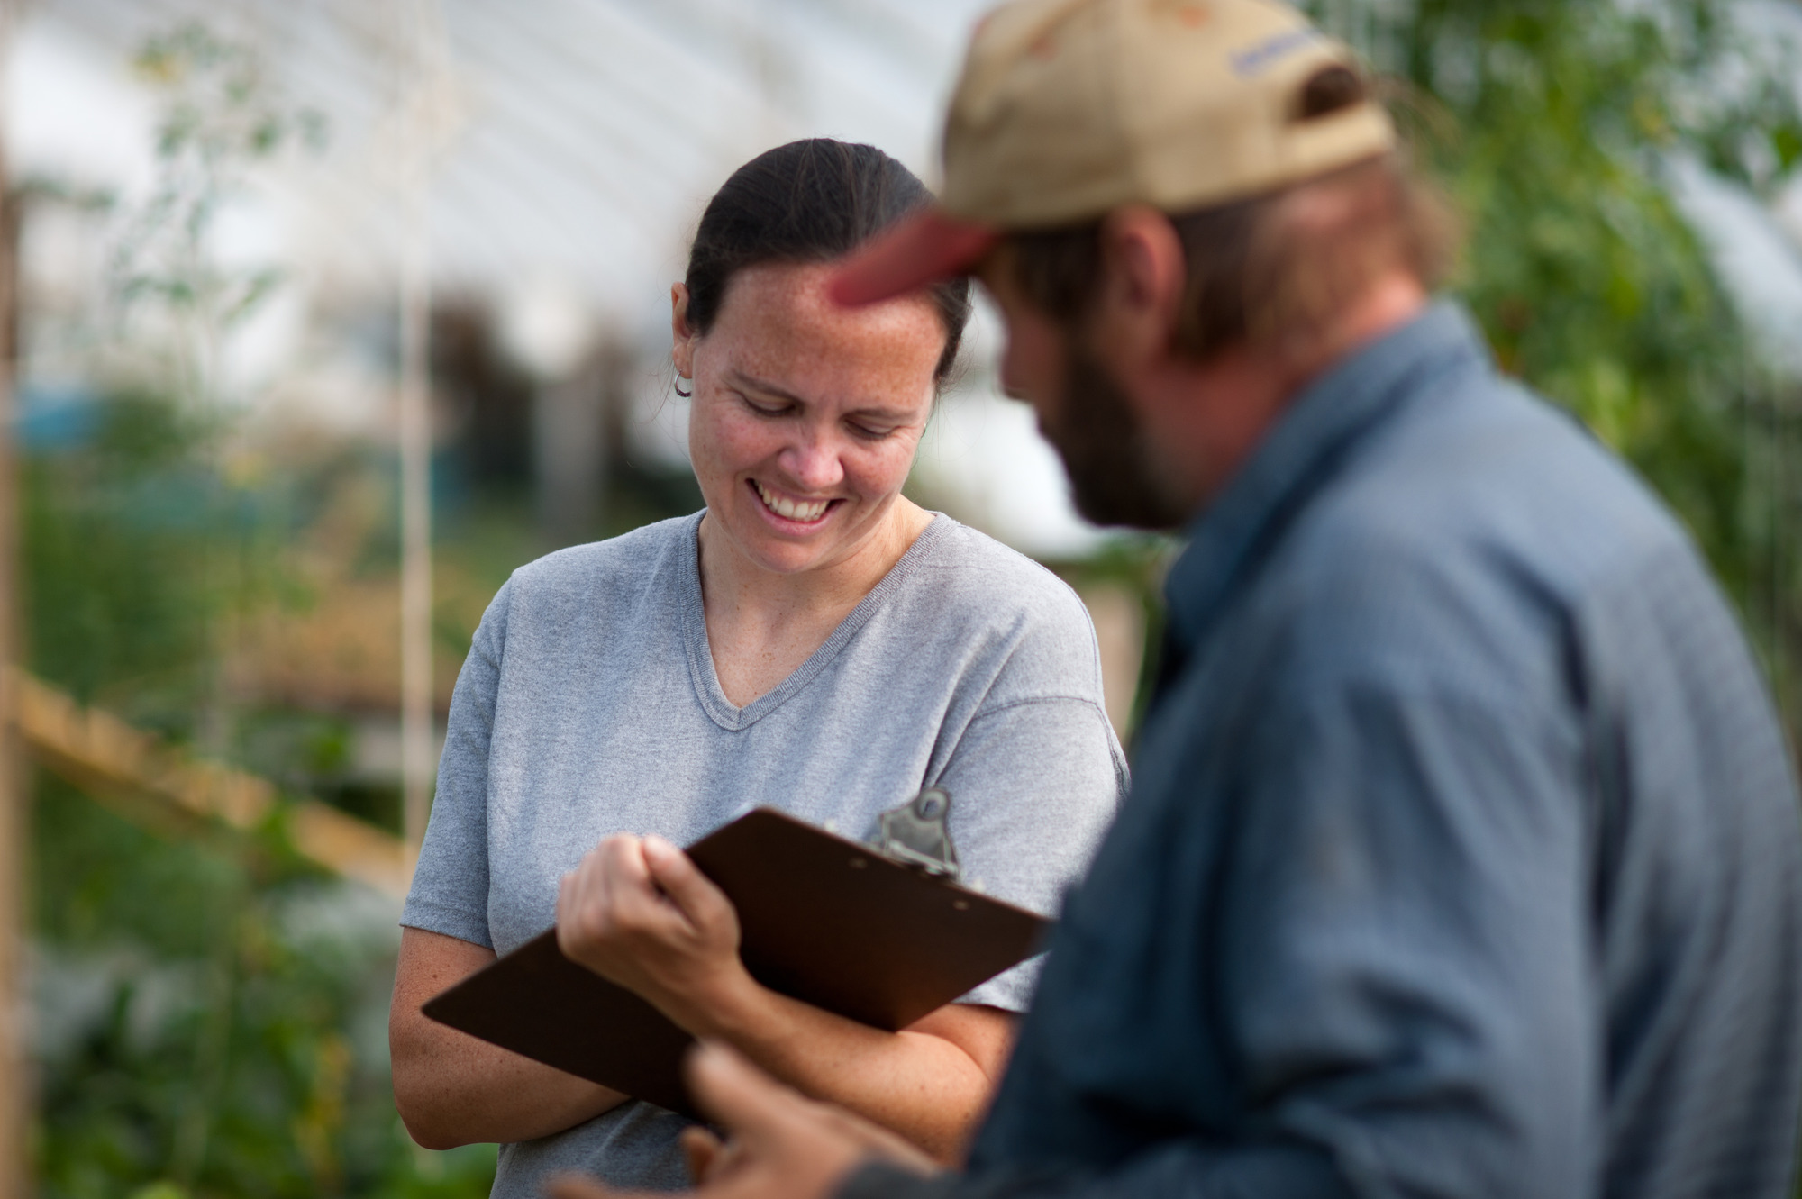
Selecting and Evaluating Farm Enterprises
Adapted from Caragh Fitzgerald slides by
Donna Coffin

Slide 2
You can make money on any enterprise.
You can lose money on any enterprise.

Slide 3
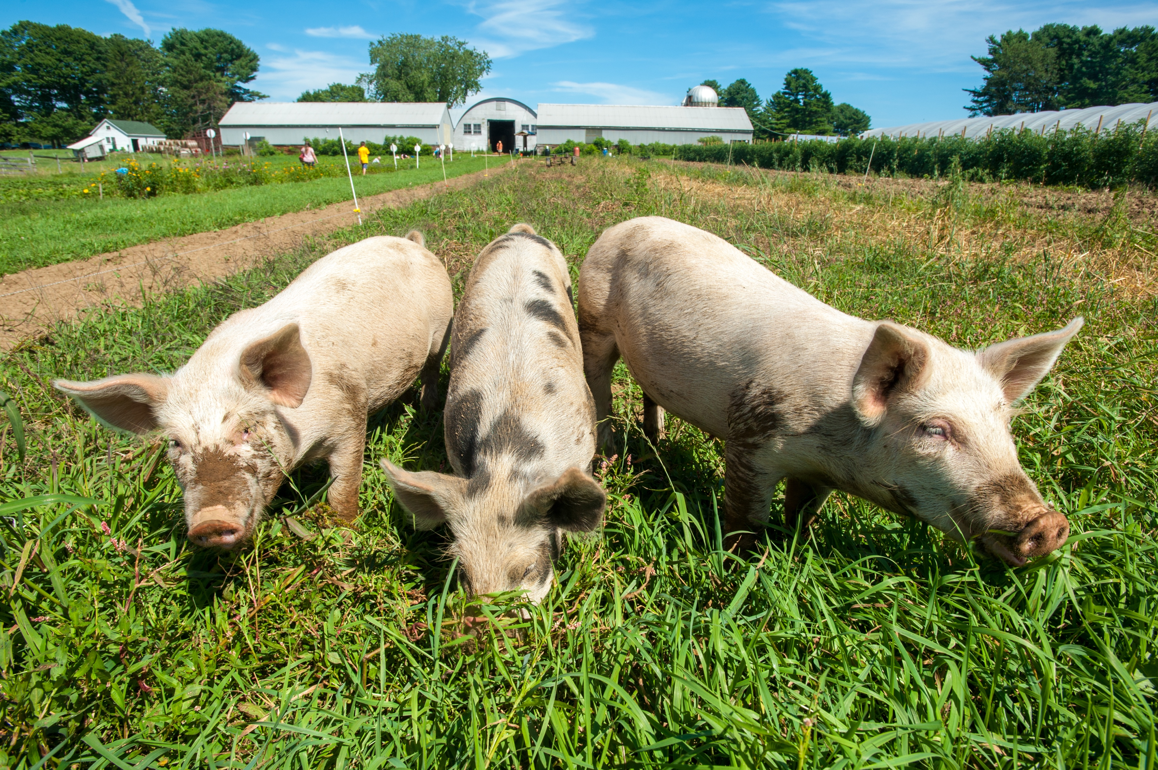
Where to Start?
What are your interests
Multiple enterprises
What are your resources
Land
Equipment
Labor
Experience, skill & knowledge
Available Money - capital
Potential profit
Available markets
Business plan will help justify investment

Slide 4
Resource Evaluation
Categories
Physical
Marketing
Management & Labor
By-product
Financial
Farming Alternatives publication
ATTRA’s Evaluating a Farming Enterprise

Slide 5
Results – Resource Evaluation
Look for underutilized resources
Room for growth
What are limiting resources?
What resources are at capacity?
What might you be able to find a way around?

Slide 6
Generating Ideas
Penn State’s Ag Alternatives Website – 90 listings
https://extension.psu.edu/business-and-operations/business-management/ag-alternatives
Missouri Alternatives Center
from Agribusiness to Worms
http://agebb.missouri.edu/mac/
Search term + Site:edu for university results

Slide 7
From Missouri Alternatives Center
Rabbits
Raised beds
Raspberries
Raspberries, organic
Reindeer
Rheas
Rhubarb
Roadside stands
Rock gardens
Root cellars
Commercial Rabbit Production Management Wheel (University of Missouri Extension)
Concerns To Consider When Building Rabbit Facilities (Mississippi State University)
Cottontail Rabbit Management (MO Dept of Conservation)
Domestic Rabbits and Their Care (Mississippi State University)
Meat Rabbits (Cornell University)
Rabbit (North Dakota State University)
Rabbit Barn Plans #1 (North Dakota State University)
Rabbit Barn Plans #2 (North Dakota State University)
Rabbit Barn Plans #3 (North Dakota State University)
Rabbit Facilities for the Northern Plains (North Dakota State University)
Rabbit Housing Plans (Mississippi State University)
Rabbit Hutches Plans #4 (North Dakota State University)
Rabbit Management (MO Dept of Conservation)
Rabbit Production (Penn State University)
Rabbit Production 101 (Alabama A&M University)
Raising Rabbits (Kansas State University)
Raising Rabbits: Helpful Suggestions for Beginners (Washington State University)
Slaughtering and Dressing Rabbits (Mississippi State University)
Starting A Rabbit Enterprise (Mississippi State University)
Summer Heat and Reproductive Management for Rabbits (Alabama A&M University)

Slide 8
Generating Ideas
Ask everyone
Neighbors, farmers, advisors, lenders, etc.
Look at popular press
Magazines (ag & food), newspapers, trade journals, ag magazines
Look for needed products
What isn’t here?
Observe when you travel

Slide 9
What will you grow or raise? How will you grow or raise it? How will you market it? Will you change the enterprise into something else?

Slide 10
Sifting Through Ideas Quality of benefits of each enterprise Farming Alternatives – NRAES-32 p. 24
Enterprise type preferred by family
Special features preferred by family
Uses underutilized physical resources
Has market potential
Uses underutilized management & labor
Uses existing by-products
Family resources can cover startup costs

Slide 11
Idea Evaluation Chart from Ag Alternatives NRAES-32

Slide 12
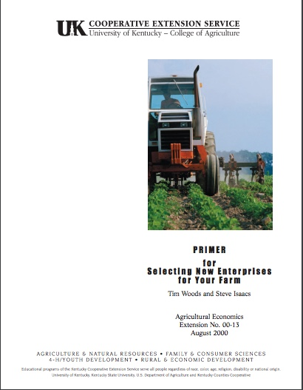
University of Kentucky PRIMER http://www.uky.edu/Ag/AgEcon/pubs/ext2000-13.pdf
Profitability
Resources
Information
Marketing
Enthusiasm
Risk

Slide 13
The PRIMER Method SCORE SHEET
Profitability
Resources
Information
Marketing
Enthusiasm
Risk
Cash cow …………………………….10
Probably profitable: just needs a little planning …………………………….… 8
Profitable if I can get some start-up funds …………………………..……… 6
Profitable: but easily duplicated and limited market …………..……………. 4
Can make a profit if all the stars line up right …………………..…………… 2
Profits unlikely: but still looks like fun 0

Slide 14
The PRIMER Method SCORE SHEET
Profitability
Resources
Information
Marketing
Enthusiasm
Risk
Have everything I need ………… 10
Need a few minor/low-cost items.. 8
Missing one important resource, but can acquire it at some expense … 6
No experience with enterprise, but can develop it in time ……………. 4
No experience and need to acquire some major resources …………... 2
Starting from scratch ………….…. 0

Slide 15
The PRIMER Method SCORE SHEET
Profitability
Resources
Information
Marketing
Enthusiasm
Risk
Production and marketing info well in hand …………………………………. 10
Need to do a little homework ………. 8
Need to do a fair amount of homework …………………………………………. 6
No one has ever seen this done here before, but can find info elsewhere .. 4
No access to a computer, extension office or library ………………………. 2
Starting from scratch ……………….. 0

Slide 16
The PRIMER Method SCORE SHEET
Profitability
Resources
Information
Marketing
Enthusiasm
Risk
Promising, accessible markets exist: customers begging for this product …...10
Accessible markets but needs a little effort to develop …………………………. 8
New retailing / cooperative marketing will have to be developed, but still a good market ……………………………………. 6
It may take some time and money to help consumers appreciate the value of this product/service ………………………….. 4
The market is pretty well saturated with similar products …………………………. 2
Selling ice to Eskimos ………………….. 0

Slide 17
The PRIMER Method SCORE SHEET
Profitability
Resources
Information
Marketing
Enthusiasm
Risk
I can’t sleep at night, this idea is so exciting ………………………………10
I’m excited but some of my family members are reluctant ……………… 8
It’s as good an idea as any of the others I’ve come up with ….………… 6
I could get excited, but only if it works out fairly soon ……………….……….. 4
I’m out at the first sign of rough sailing ……………………………….………… 2
Why do I even have to do this? ….… 0

Slide 18
The PRIMER Method SCORE SHEET
Profitability
Resources
Information
Marketing
Enthusiasm
Risk
Comfortable with return estimates relative to the risk involved ……… 10
I’m reasonably comfortable ………. 8
Somewhat comfortable …………… 6
It looks OK, but there’s just a lot still unknown ……………………………. 4
I think I could make it, but there are possibilities for significant loss …… 2
I’m better off buying a lottery ticket. 0

Slide 19
The PRIMER Method TOTAL SCORE
Profitability
Resources
Information
Marketing
Enthusiasm
Risk
Very promising, move ahead
……………………………….. 48-60
Has promise, but will still need some work ………………….. 37-47
Has promise and some serious hurdles, carefully evaluate whether this is a good fit …………… 28-37
Beware! May not be a good fit
…………………………………. <26

Slide 20
Compare Enterprises
PRIMER | Gourds & Indian Corn | Xmas Trees | Poinsettias
Profitability | 10 | 5 | 3
Resources | 8 | 4 | 0
Information | 4 | 3 | 8
Marketing | 5 | 5 | 8
Enthusiasm | 5 | 8 | 10
Risk | 10 | 5 | 3
Total | 42 | 30 | 32

Slide 21
Getting More Experience
MOFGA’s apprentice & journeyperson programs
MOFGA.org
Paid work for an existing farmer
Volunteer for an existing farmer
Discuss your goals in advance
Work on your own at a small scale

Slide 22
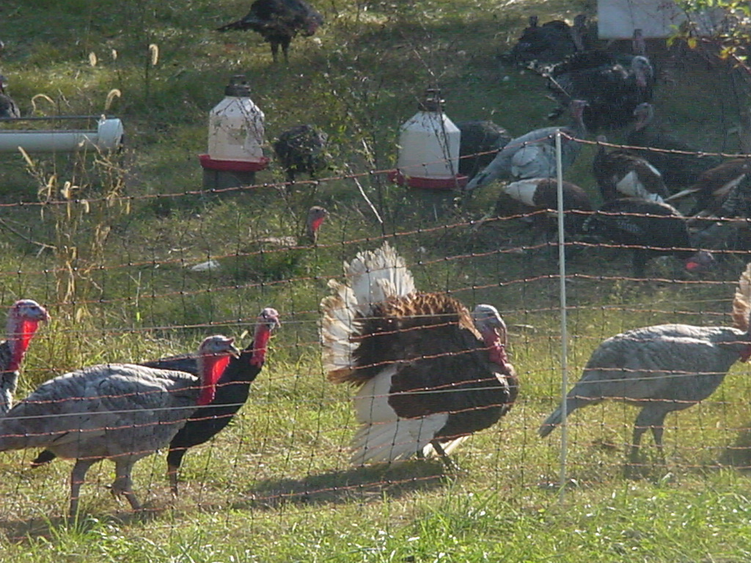
What’s the Right Fit?
You love it
You can produce it
You can sell it for a reasonable profit
It allows you and your family to have the sort of life you want.

Slide 23
Remember, a good idea doesn’t have to be a new idea; it just has to fit your needs, work on your land, pay the bills, and generate a profit.

Slide 24
Enterprise Budget :
Provides a listing of all income and expenses associated with a the production and marketing of a product.
Includes estimates of yield
per animal
per acre
Labor input (including owners)
Cost of production
Break even price
Return to management

Slide 25
Enterprise Budget :
List the initial costs
land preparation, seed, fertilizer, etc. OR
purchase of animals, feed, etc.
Includes a portion of taxes or land ownership costs and equipment costs for production of that product
There may be situations where the first year costs are higher than for subsequent years (perennial crops) as establishment costs.
Let’s look at a couple of enterprise budgets

Slide 26
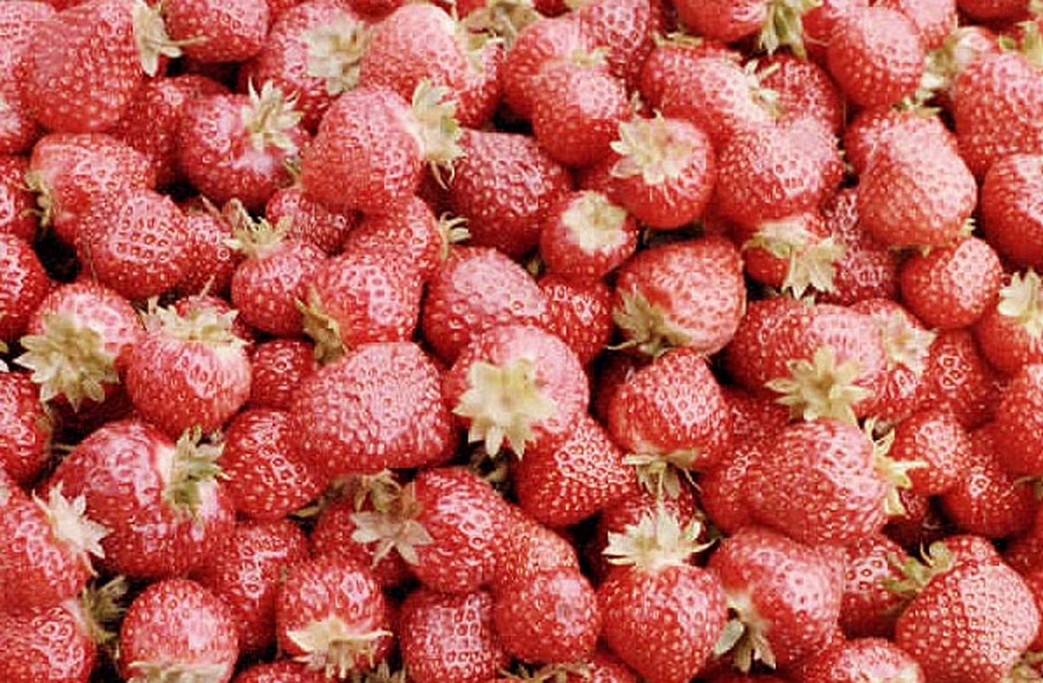
An Enterprise Budget Example
Strawberries: Initial Resource Requirements
Land
1 acre
Labor
Land preparation: 4 hours
Establishment: 60-65 hours
Production (year 1): 55-60 hours
Custom harvest labor (mature): $4,000 - $6,000
Capital
Land Preparation: $300 - $400
Strawberry Plants: $900 (dormant crowns) - $4,000 (plugs)
Mulch: $180 - $300 (each year)
Other: $100 (fuel, repairs, maintenance, machinery depreciation)
Courtesy of Penn State’s College of Agricultural Sciences: Strawberry Production agalternatives.aers.psu.edu

Slide 29
Returns on Matted Row (June-bearing) Harvested Fruit
Courtesy of Penn State’s College of Agricultural Sciences: Strawberry Production agalternatives.aers.psu.edu

Slide 30
Returns on Plasticulture Harvested Fruit
Courtesy of Penn State’s College of Agricultural Sciences: Strawberry Production agalternatives.aers.psu.edu

Slide 31
Strawberries: The Bottom Line
Establishment Costs (Years 1 & maybe 2)
- $3,500 - $7,800
Land prep, plants, irrigation, etc.
Labor
Mature Plantings (Years 2 +)
- $9,300*
*Most of this is labor and packaging
Courtesy of Penn State’s College of Agricultural Sciences: Strawberry Production agalternatives.aers.psu.edu

Slide 32
Strawberries: Net returns
Plasticulture
$1,425 - $26,165/ acre
Dependent upon:
Yield (9,800 - 14,000 lbs./acre)
Price ($1.79 - $3.21/lb.)
Matted Row (June Bearing)
$2,400 - $19,000/acre
Dependent upon:
Yield (8,000 - 12,600 lbs./acre)
Price ($1.43 - $2.50/lb.)
Courtesy of Penn State’s College of Agricultural Sciences: Strawberry Production agalternatives.aers.psu.edu

Slide 33
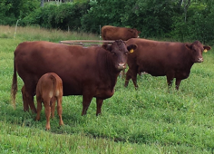
Beef Cow-Calf Budget
Courtesy of Oklahoma State Ag Economics Extension http://agecon.okstate.edu/budgets/

Slide 34
Beef Cow-Calf Budget

Slide 35
Beef Cow-Calf Budget

Slide 36
Beef Cow-Calf Budget

Slide 37
Beef Cow-Calf Budget

Slide 38
Beef Cow-Calf Budget

Slide 39
Beef Cow-Calf Budget

Slide 40
Beef Cow-Calf Budget

Slide 41
Beef Cow-Calf Budget

