Slide 1
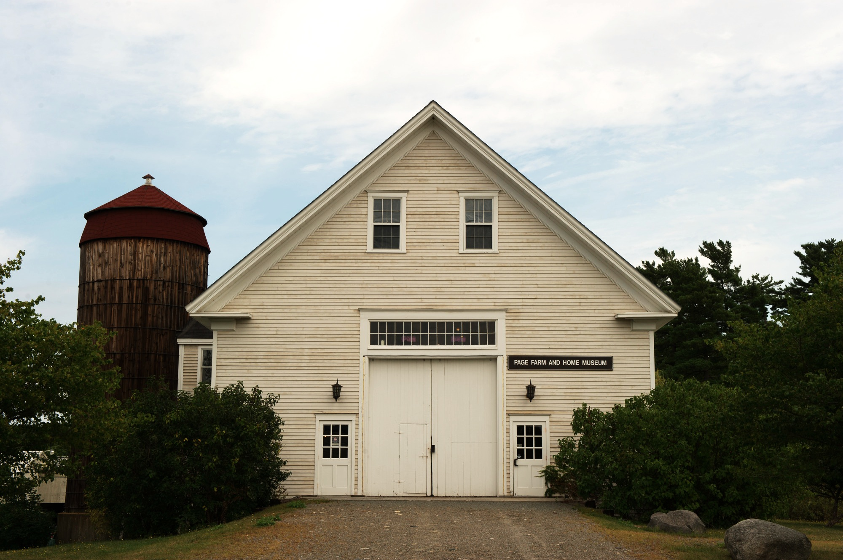
Farm Loans & Grants
http://farminmaine.wordpress.com

Slide 2
Other Sources of Funds
Small Business Administration Guaranty Loans
Personal Savings
Credit Cards
Venture Capital Dollars – “Go Fund Me”
Outside Ownership
Grants

Slide 3
Finding Funds for Farming
Old publication from the Maine Department of Agriculture, Conservation, and Forestry (~2010)
Lists county offices of entities that make loans to farms
Lists potential Grant Sources

Slide 4
Other Loan Sources http://bit.ly/moreloans
No Small Potatoes Investment Club
Slow Money Maine
MOFGA
Barnraiser
Kickstarter
KIVA ZIP
New Maine Credit Union

Slide 5
Grants
Aubrey give a more rosy picture for grant success
Must have a track record
Very competitive
Not typical for first farming venture
Follow Directions!
Submit before deadlines!

Slide 6
Financial Statements Needed
Income Statement
Salary
Farm Income
Other
Statement of Financial Position
Aka Balance Sheet or Net Worth Statement

