Slide 1
Conducting Needs Assessments: An Introduction
Amy Harder, Professor & Director of PDEC
University of Florida

Slide 2
Agenda
Welcome
Defining Needs vs. Wants
How to Plan a Needs Assessment: The Three Phases
Data Collection Methods Overview
Practice and Debrief: Nominal Group Technique
Q&A

Slide 3
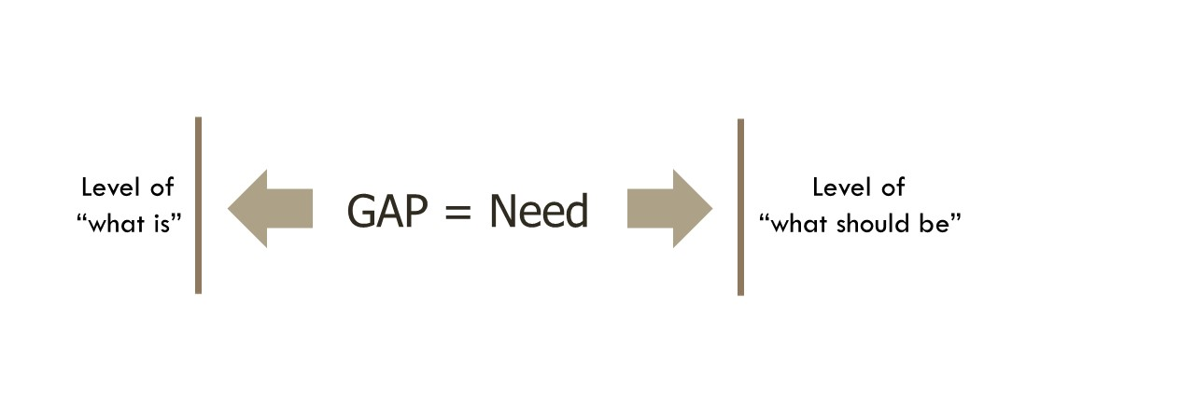
Defining the ‘Need’
Want = “I want a vibrant, green yard”
Extension agent = less fertilizer, less water, implement FFL
The Need = importance of FFL, read fertilizer labels, properly install and run a water timer, incorporate FL-friendly plants

Slide 4
Making Time for a Needs Assessment
A needs assessment takes time. However, there are many opportunities to plan for a needs assessment:
  If you’re a new agent or move into a new position
  After you receive a promotion
  Towards the end of the year before your POW (plan of work)

Slide 5
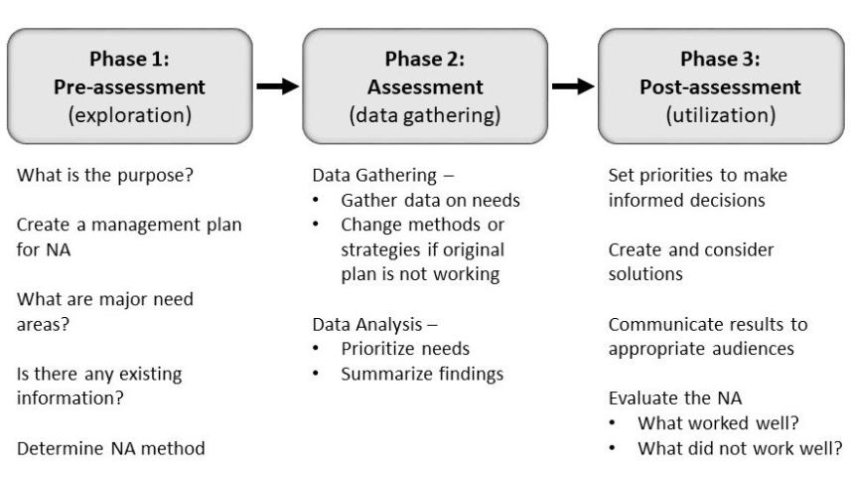
Three-Phase Model of Needs Assessment
(Witkin & Altschuld, 1995)

Slide 6
Common Types of Data Collection Methods
Surveys
Interviews
Individual
Focus Group
Future-Oriented Needs Assessment Procedures
Scenarios
Future Wheels
Causal Analysis
Records and Social Indicators
Basic
Delphi
Fishbone Diagram
Cause & Consequence
National Association of Counties
MDACF
U.S. Census

Slide 7
Conducting the Needs Assessment Series
Introduction
Using Needs Assessments in Extension Programming
Educator Motivations, Barriers, and Objections
Audience Motivations, Barriers, and Objections
Phase 1 – Pre-Assessment
The Borich Model
The Nominal Group Technique
The Delphi Technique
Causal Analysis Techniques
http://edis.ifas.ufl/edu
Search “needs assessments”

Slide 8
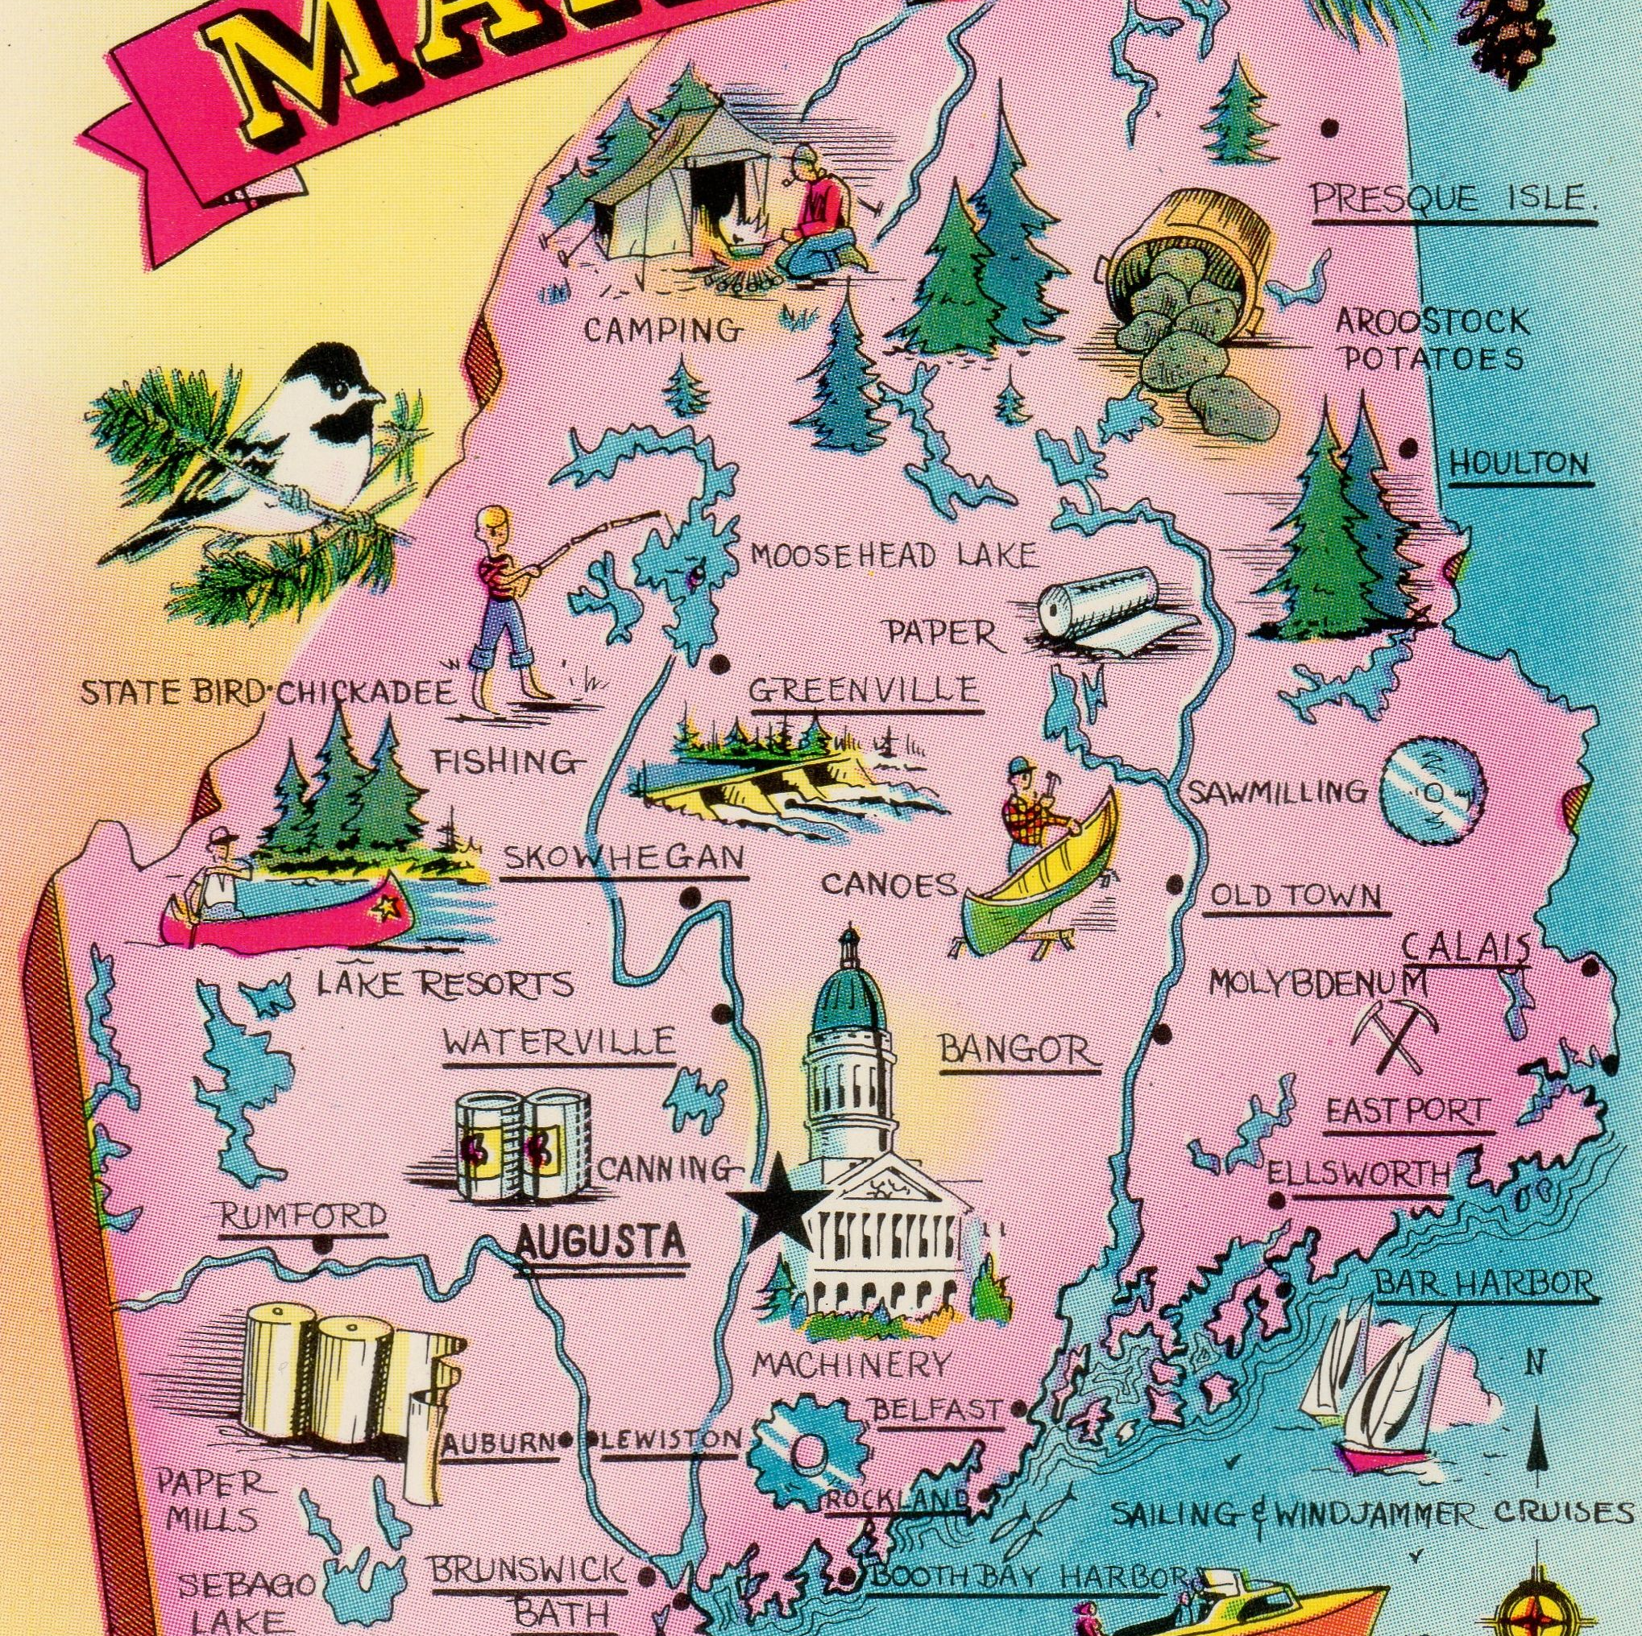
Nominal Group Technique
What are the biggest challenges facing UMaine Extension in the next five years?

Slide 9
Debriefing the NGT
Facilitation
Participation
Applicability for Extension

Slide 10
Questions?
Resources:
1. Caillouet, O., Benge, M., & Harder, A. (2020). Existing data sources as tools for entry-state extension professionals. Journal of Extension, 58(6), Article 2. https://tigerprints.clemson.edu/joe/vol58/iss6/2/
2. Conducting the Needs Assessment fact sheet series: https://edis.ifas.ufl.edu/topic_series_conducting_the_needs_assessment
3. Secondary data: https://pdec.ifas.ufl.edu/lrp/secondary-data.shtml

