Slide 1
EVERYDAY INCLUSION
Harnessing the power of diversity to build stronger teams and organizations

Slide 2
AGENDA
Defining Diversity, Equity, Inclusion & Belonging
The Power of Diverse Teams
Psychological Safety and Belonging
Building a Culture of Inclusion

Slide 3
DEFINING DIVERSITY, EQUITY, INCLUSION & BELONGING

Slide 4
Defining DEI&B
DIVERSITY is made up of the numerous human attributes that differentiate people from each other.
EQUITY is about treating people fairly. It’s not the same as equality, which is treating everyone the same.
INCLUSION is made up of the behaviors that proactively recognize, respect and welcome diversity.
BELONGING is a mental and emotional state of feeling seen, valued, and supported for your uniqueness. “Belonging is the opposite of fitting in.” ~ Brene Brown

Slide 5
Diversity is more than meets the eye

Slide 6
THE POWER OF DIVERSE TEAMS

Slide 7
Diversity & Business Results
Management teams with a wider range of educational and work backgrounds produce more innovative products
(2011, Journal of Product Innovation Management)
Companies that improved inclusion of persons with disabilities
4x more likely to outperform shareholder returns of their peer group
(2018, Accenture)
Companies in the
top quartile for racial/ethnic diversity are 33% more likely to have financial returns above industry medians
(2015, McKinsey)
A study of 20,000 companies found that companies with more female executives are more profitable
(2016, Current Opinion in Psychology)

Slide 8
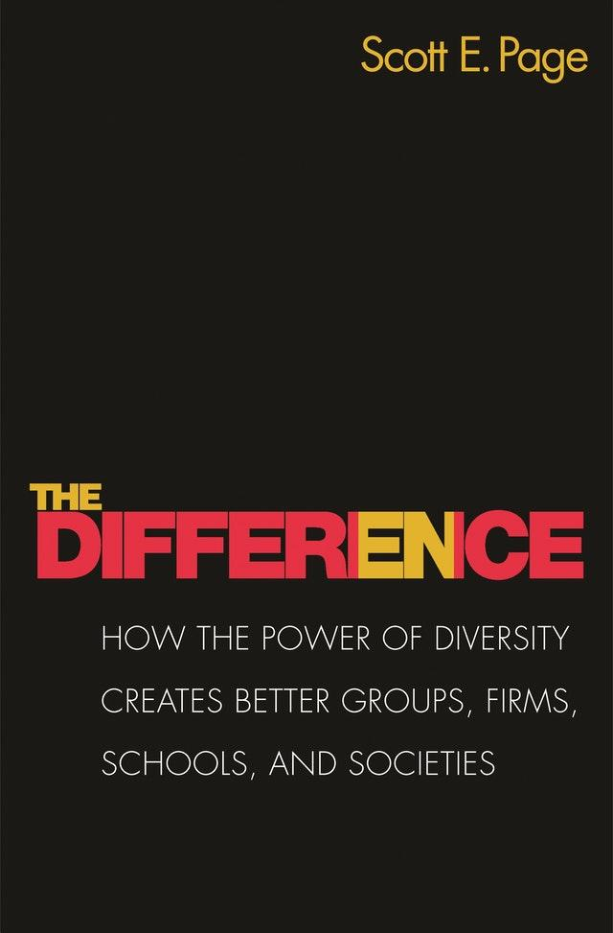
The power of diverse teams
We now have 30 years of data showing teams win. Whether in academic settings, investing, or even songwriting.
Teams beat individuals and diverse teams beat homogeneous teams.”
~Scott Page

Slide 9
Superadditivity
“One plus one can equal three –
but only if the two 1s are diverse.”

Slide 10
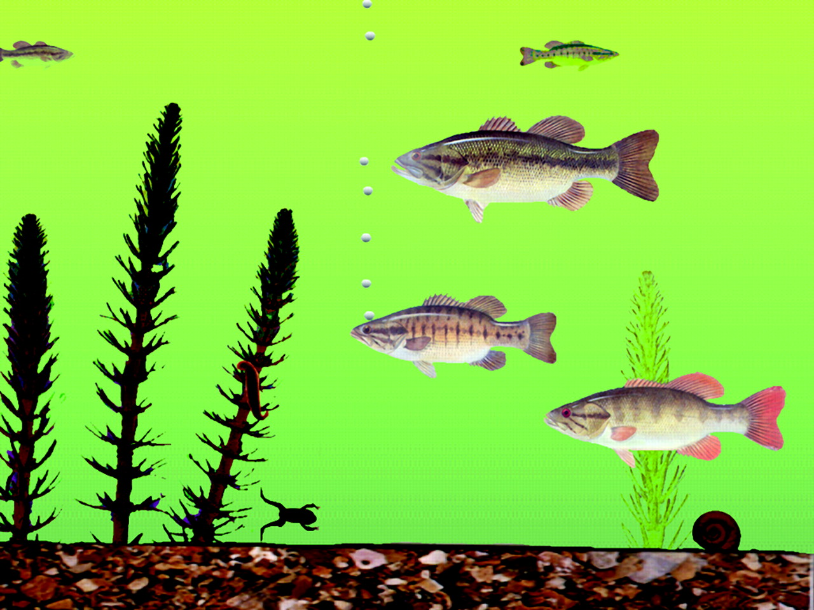
Differential perception
What do you see?
Source: The Geography of Thought http://ns.umich.edu/Releases/2003/Feb03/r022703a.html

Slide 11
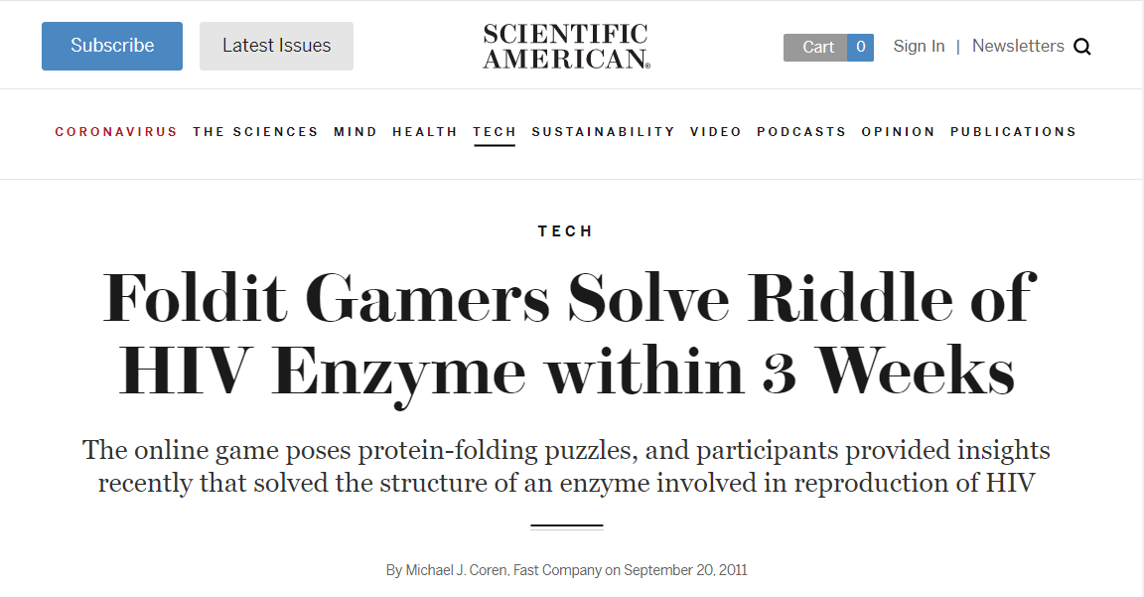
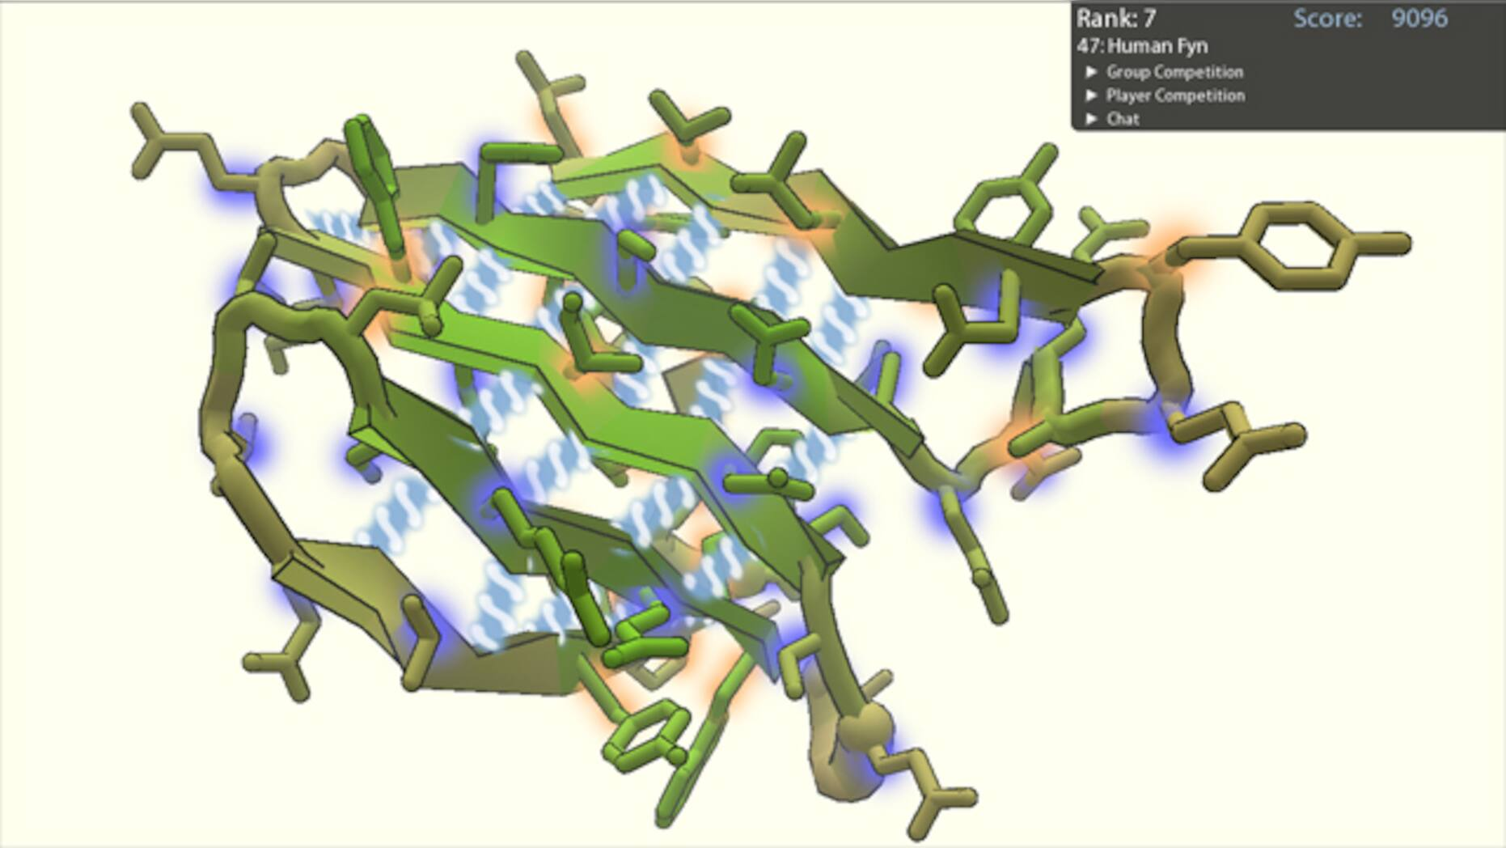
Differential perception

Slide 12
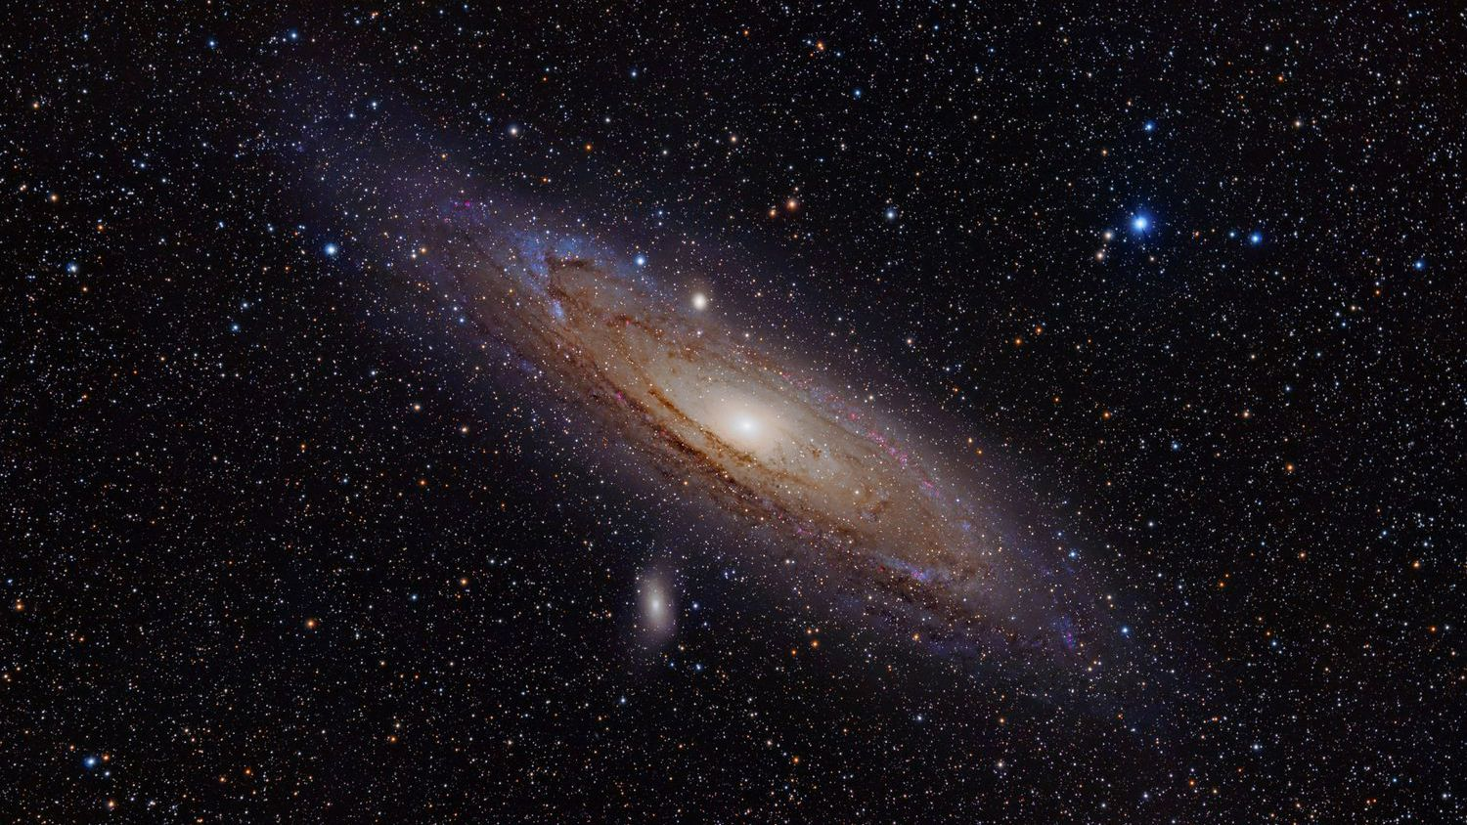
Collective intelligence
The Universe of Human Knowledge
What you know

Slide 13
Alternative uses task
Grab a pen & paper

Slide 14
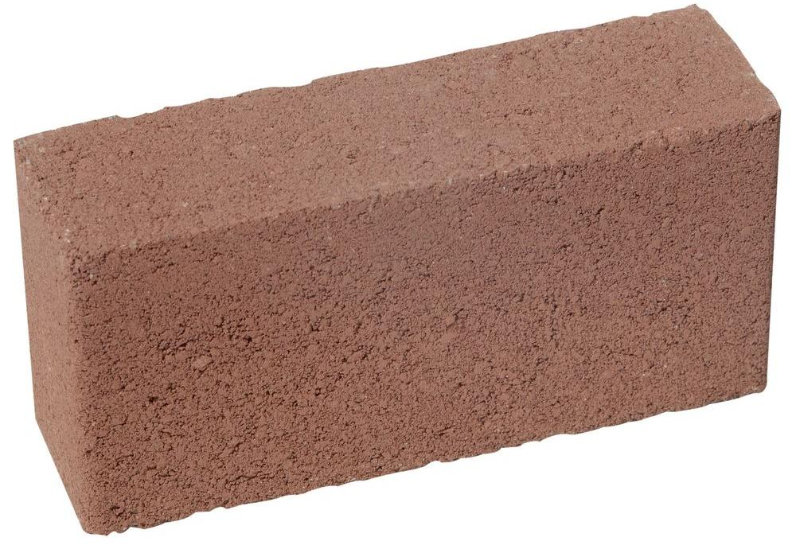
Alternative uses task
List as many uses for a brick as you can.

Slide 15
What’s on your list?
Boat anchor
Build a house/wall
Break a window
Secure a tablecloth for a picnic
Hold a tarp in place for a roof repair
Displace water in a toilet tank
Couch for a Barbie doll
Hammer in tent stakes
Coaster for a medieval knight
Level a table with uneven legs
Sharpen a knife
Cook chicken under a brick
Use as ballast for a boat
Break into pieces and use as arrowheads

Slide 16
One tip for better brainstorming

Slide 17
Factors correlated to collective intelligence
Diversity of gender, race and social class
Equity and inclusion in group dynamics
Turn-taking
Social sensitivity
Psychological safety
Evidence of a Collective Intelligence Factor in the Performance of Human Groups October 2010 Science
On Racial Diversity and Group Decision Making: Identifying Multiple Effects of Racial Composition on Jury Deliberations https://www.apa.org/pubs/journals/releases/psp-904597.pdf
Dittmann, A. G., Stephens, N. M., & Townsend, S. S. M. (2020). Achievement is not class-neutral: Working together benefits people from working-class contexts. Journal of Personality and Social Psychology, 119(3), 517–539. https://doi.org/10.1037/pspa0000194

Slide 18
PSYCHOLOGICAL SAFETY AND BELONGING

Slide 19
Psychological safety
Openness
Curiosity
Vulnerability
Inspiration
“Psychological safety is not at odds with having tough conversations – it is what allows us to have tough conversations.”
~Amy Edmondson, 2021
Trust
Groupthink
Blame
Risk Aversion
Silence
Shut Down

Slide 20
Belonging matters
A sense of belonging in the workplace is the ONE single metric that is consistently tied to workplace commitment, motivation and pride (Paradigm, 2018)
High belonging is linked to a 56% increase in job performance, a 50% drop in turnover risk and a 75% reduction in sick days (HBR, 2019)
Psychological safety is linked to better team performance and greater innovation (Google, 2012)
LGBTQ+ employees who can be “out” at work are 30% more productive than employees who must hide their sexual orientation (Frost, 2014)

Slide 21
BUILDING AN INCLUSIVE CULTURE

Slide 22
Where does culture happen?

Slide 23
“Meetings are where culture forms, grows, and takes hold.” ~HBR, 2019

Slide 24
The meet guide
M
E
E
T

Slide 25
Make participation easy
Intentional and thoughtful planning will bring out the best in everyone:
Share the agenda ahead of time using collaborative tools
Be mindful of your room setup
Plan for virtual participation and inclusion
M

Slide 26
engage everyone
Create a communication pattern that predicts success:
Create a ”no lurkers” rule
Give each other the gift of your full attention
Proactively invite each person to speak
Redirect questions to the group
Practice YES AND
E

Slide 27
Ensure equity
Observe the dynamics in the meeting & intervene to share the power:
Who’s speaking the most?
Who’s been interrupted?
Whose ideas are praised or valued?
Who hasn’t been acknowledged?
Who’s hanging back or checked out of the discussion?
E

Slide 28
Tap into collective intelligence
Ask questions to encourage disagreement:
What are we missing here?
How might this go wrong?
What holes can you poke in this idea?
What challenges do you see?
What’s an alternative to this plan?
Who’s going to disagree with this, and why?
Would you personally bet $1000 on our success?
T

Slide 29
WHERE WE’VE BEEN
Defining Diversity, Equity, Inclusion & Belonging
The Power of Diverse Teams
Psychological Safety and Belonging
Building a Culture of Inclusion

Slide 30
Q&A

Slide 31
THANK YOU!
carajpelletier@gmail.com
@radicalwelcome
Linkedin.com/in/youcansitwithme

