Slide 1
Get out your Gazetteer: Roadmap Update
Tuesday, November 1, 2022
Roots to Blooms: Understanding our History and Cultivating our Future
Hannah Carter

Slide 2
My goals here today…
Review the origins of the UMaine Extension Roadmap
Share the process to date
Discuss the timeline and accomplishments
Set the stage for the next three days and the short-term future of the organization

Slide 3
Summer of 2020
Several months into a global pandemic that no one had been through before—”flying the airplane as we are building it”
1 year anniversary of my assuming my role
We needed to touch base with you all, we sent a survey with two objectives:
Determining the challenges and opportunities of working remotely
Thinking of the future of the organization
What is one thing you would change about UMaine Extension, what would it be and why?

Slide 4
Fall of 2020
Survey had an incredible completion rate.
What I’ve learned through the years leading processes like this:
It must be relevant and represent the entire organization.
It must be built from the grassroots, not top down.
It must involve those who are interested in doing the work.
It must be able to be done, not sit on a shelf.
It must not waste anyone’s time.
Developed the “Roadmap” idea—not a 5-10 year strategic plan, but a 1-3 year plan (or “map”) to give us direction as we came out of the pandemic.
After “Roadmap” is complete, will undergo a full-scale strategic plan

Slide 5
Survey Says!
Data easily fell into five themes:
Considering how we operate
Enhancing collaborations
Enhancing our financial future
Programming for the future
Successful communications and marketing
I asked during an Extension Connections for volunteers to serve on theme committees, wanted a cross section of the organization.
From those volunteers, I asked for someone to step up and be the committee leader.

Slide 6
Fall 2020 – Spring 2021
Committees met throughout the fall and into 2021
Goal was to present during the March 2021 Virtual “All Organization Meeting”
Committees were tasked with developing a report and actual recommendations for the organization

Slide 7
2021 UMaine Extension Virtual All Staff Conference
Again, tremendous participation!
Each committee gave a report and their recommendations with time for questions at the end from participants.
At the end of the meeting, a survey was sent with all the recommendations of all the committees to the organization for feedback.

Slide 8
Extension Roadmap Steering Committee
Again, tremendous participation when we sent the survey to the organization with the recommendations from the Roadmap theme committees.
Asked again, for volunteers to serve on the “Steering Committee” to review the recommendations and organizational input and help determine paths forward.
Blown away by the response for volunteers, who represented all areas of the organization.
Steering Committee met from August 2021 to April 2022.
All meeting notes are available on our Steering Committee website.

Slide 9
But then, there were a few bumps in the road…
PFAS
Retirements
Vacancies/staff turnover
General sense of fatigue/burn-out
Push to get back to “normal”
My assuming leadership of another unit
It’s kind of been a year!

Slide 10
So here we are!
“Never waste a good crisis.”
“We aren’t using the same cell phone we did 20 years ago.”
“We need radical thinking, creative ideas, and imagination.” –Mairead Corrigan
My commitment to this process:
We do it together.
There is open communication.
We know change will be hard, but in the end it will be worth it.
All ideas and opinions are valued and heard.

Slide 11
What’s the plan moving forward?
Tomorrow we will be lead through an innovation process by our newly named Associate Dean, Dr. Jason Bolton.
Throughout the three days there are opportunities to meet, have conversations and share ideas.
At the end of this conference, all ideas will be gathered, analyzed and a process for moving forward will be determined.
There will be opportunities to be a part of it.
A timeline moving forward will be developed and communicated.

Slide 12
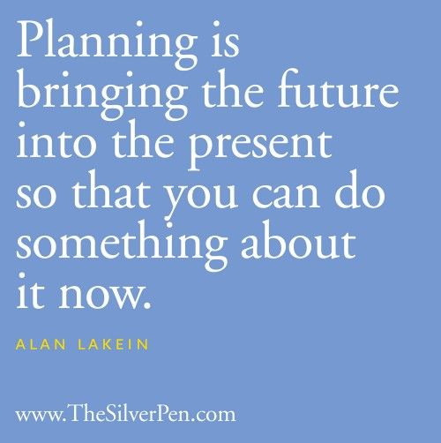
Questions & Thoughts?

