Slide 1
Practical Approaches to Program Evaluation
Dr. Amy Harder, Professor
University of Florida

Slide 2
Agenda
Discuss Bennett’s Hierarchy
Identify how Bennett’s Hierarchy integrates into the TOP Model
Identify evaluation methods for each level of Bennett’s Hierarchy
Q&A

Slide 3
Useful Definitions
Resources – time, money, people, materials
Activities – classes, workshops, mentoring
Participation – who should attend? Who did?
Reactions – interest in the topic
KASA – knowledge, attitudes, skills, aspirations
Practices – adopted behaviors
SEE conditions – social, economic, environmental

Slide 4

Bennett’s Hierarchy
Developed to help program planners evaluate their programs
  -Why would evaluation be important?
  -Who asks for evaluation results?
Hierarchical – each step is harder to accomplish than the one before it
Top step is most valuable (and costly, and difficult!)

Slide 5
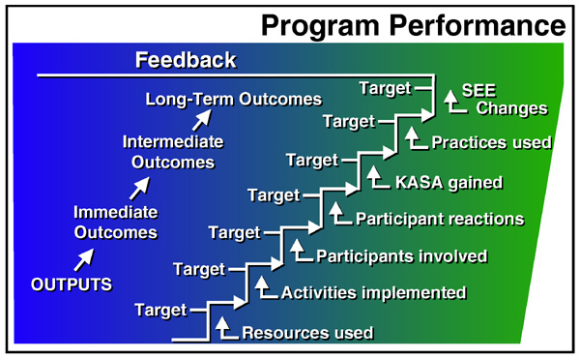

Slide 6
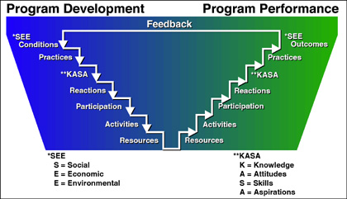
The TOP Model

Slide 7
Tracking Participation: A Historical Scenario
An evening educational event is being hosted by Extension. As usual, there’s a sign-in sheet up front that is used to track participation. Attendees indicate their name, address, DOB, gender, race, and ethnicity in various columns on the sheet. This information helps track # of participants and information required for Civil Rights purposes.

Slide 8
Tracking Participation: A Better Scenario
An evening educational event is being hosted by Extension. Participants have pre-registered for the event using an online form (e.g., Eventbrite) which asked them to provide personal information at that time. Upon arrival at the event, they simply check a box on the sign-in sheet to indicate their attendance. Individuals who did not pre-register are given paper copies of the registration form to fill out and submit directly to Extension.

Slide 10
Tracking Participation: Online Scenarios
An online event is being hosted by Extension Participants have pre-registered for the event using Zoom’s built-in features. Nobody can join unless they have registered. The conferencing software provides an attendance report after the event.
An online event is being hosted by Extension. Pre-registration was not required, so Extension uses the built-in survey feature to collect participant information before the event finishes.
A 4-H volunteer is hosting an online event for 4-H seniors on Facebook Live. Youth protection laws restrict the use of the comments section. The volunteer posts a QR code at the end of the event which takes the youth to a quick survey form which is used to track attendance.

Slide 11
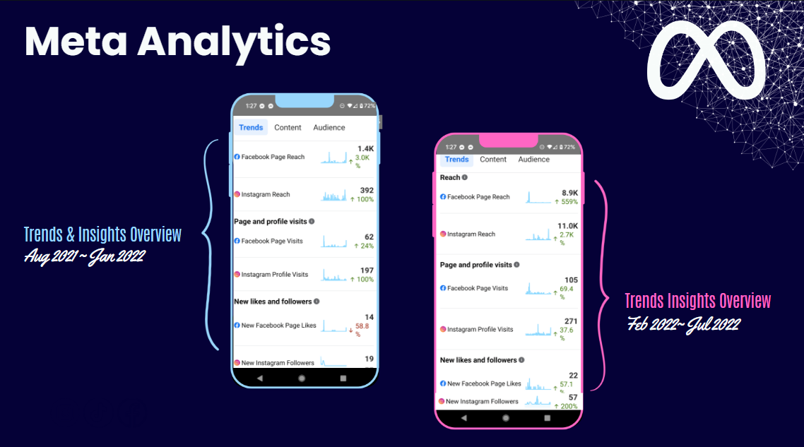
Courtesy of AJ Johnston, Extension Agent, Duval County, UF/IFAS Extension

Slide 12
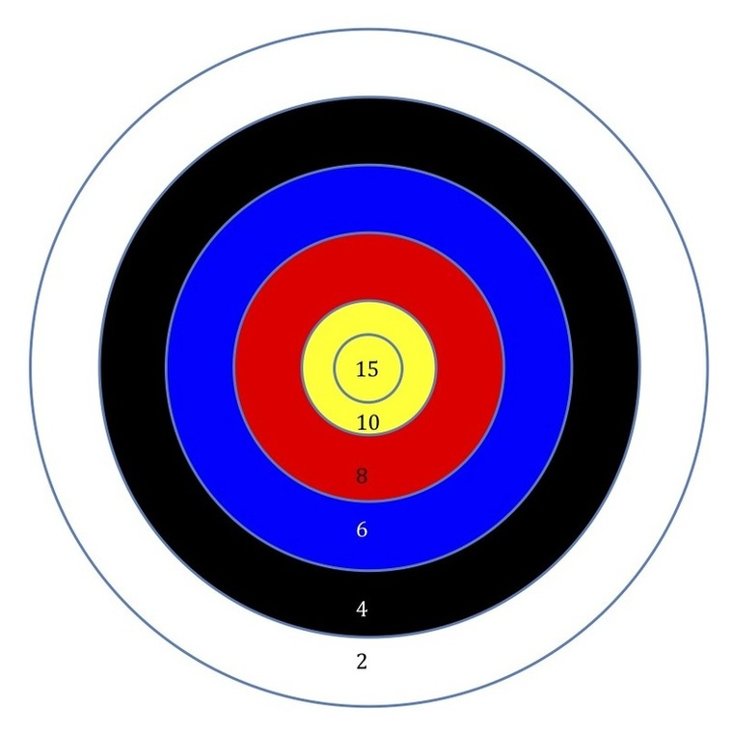
What activities should I evaluate?
Imagine the bulls-eye as the Program that you have written into your Plan of Work
What’s true about the value of a bulls-eye compared to the rest of the target rings?
Evaluate outcomes from activities closely aligned with your Program
Ignore collecting outcome data for activities that make it onto the target, but are only worth 2 or 4 points
  Often these are the “one-off” activities
  Report educational contacts only

Slide 13
Identifying Appropriate Evaluation Questions
Good: Your Plan of Work (POW) clearly identifies objectives aligned with short-term, medium, and long-term outcomes
  Knowledge, Attitude, Skills, Aspirations
  Behavior or Practice change
  Social, Economic, or Environmental changes
Better: Objectives in your POW align with targeted program outcomes at the state, regional, or national level
  Examples: EFNEP indicators, 4-H Common Measures, Sea Grant indicators
Objectives
Outcomes
Evaluation questions

Slide 14
Condition Outcome: A Safer, Healthier, More Productive Food System in Maine
Action Outcome: Adopt healthy lifestyle practices
Action step : Adopt healthy dietary practices (consume nutrient-rich foods, follow current Dietary Guidelines for Americans or DASH, etc.)
Action step : Increase consumption and preservation of healthful, locally-grown and -produced food (farm to school program, food preservation, etc.)

Slide 15
How Survey Savvy Are You?
You will have 5 - 7 minutes to individually review each survey instrument.
Your goal is to identify parts of each survey that can be improved.
We will share ideas as a group. Don’t be shy, make your mistakes with enthusiasm!

Slide 16
EFNEP Evaluation – Insights from Kate Yerxa
In 2021, 853 youth participated in Maine EFNEP. Youth participated in an average of 6.5 classes over a time frame of four months. Eighty-seven percent of youth participants completed a pre and post survey. As a result of participating in EFNEP:
83% of youth improved their abilities to choose foods according to current Dietary Guidelines or improved nutrition knowledge.
47% of youth improved their daily physical activity practices.
47% of youth used safe food handling practices more often.
50% of youth improved their ability to prepare simple, nutritious, affordable food.

Slide 17
EFNEP Evaluation – Peaking Behind the Curtain
Work in a team to create your short-term outcome assessments
  EFNEP has a multi-state research group that collaborated to create the instrument and the evaluation protocol
Pre-then-post or post-then-pre?
  EFNEP has participants attend multiple activities over time, making a pre-then-post assessment possible
Communicate your evaluation expectations early and often
  EFNEP staff communicate with stakeholders to ensure participants know what will be asked, why, how, who will have access, and confidentiality steps

Slide 18

Evaluating Reactions & Short-Term Outcomes –
The Virtual Edition!
Virtual programming changes the game for HOW to collect data….. not the ‘collect data’ part!
Important Note: Do not let your participants [walk out the door] without completing your evaluation!
Formative Evaluation – Conducting during a program to help improve the ongoing program.
Summative Evaluation – Conducted at the end of the program to assess if the program’s goals were met.

Slide 19
Online Evaluation Tools & Tricks
Do your best to collect contact information for (a) follow-up evaluation to measure behavior change, and (b) marketing efforts for future programs/volunteering.
Traditional exit surveys –Qualtrics, Survey Monkey, Google docs, etc. Post the survey link in the comments to gain increased responses.
YouTube – Add a link or QR code at the end of your video, and a link in the description “Learn more.”
Facebook – Use a link as the header of your post.
Web/social media metrics – Track participant reaction data (e.g., likes, comments, shares).

Slide 20
Identify Tools for Medium-Term Outcome Data Collection
  Types of designs: pre-test/post-test, post-then-pre, post-only, panel data (3 or more times)
  Survey methods (see https://edis.ifas.ufl.edu/topic_series_savvy_survey)
    Qualtrics libraries can support banks of questions and entire survey instruments
  Secondary data (artifacts, photos, & video)
  Qualitative data (in-person interviews, observations, phone calls, e-mails, texts)

Slide 21

4-H Evaluation: Insights from Sarah Hensley, UF
45 Programs Statewide (Drones, Beekeeping, Storytelling, Wildlife, Water, Workforce Prep, Service, Culture & Cuisine, Camp, etc.
Reached ~1,200 youth
I7 indicator Positive Youth Development ~ Belonging
Specific to the three target subject matter areas; Healthy Living, STEM, and Citizenship Leadership & Communication

Slide 22
4-H Evaluation: Peeking Behind the Curtain
Use existing (valid and reliable) survey instruments and items whenever possible
  PYD Outcomes (Belonging, Sparks, Connectedness, Engagement), 4-H Common Measures: Science Appreciation, Healthy Living, ACA Environmental Education, etc.
Make it easy for participants to access the survey
  Bitly Link (Qualtrics) provided by presenter at end of session
Send scheduled reminders
  3 Follow-up emails to registered participants by 4-H state office

Slide 23
11th hour evaluation tactics
If you have participant contact information, you can still:
Send customized survey invitations to assess medium-term outcomes
KISS principle – now is not the time for lengthy inquiries!
Prioritize POW indicators of medium-term outcomes
Send customized requests for client testimonials/success stories
If you don’t have participant contact information, you can still:
Email a survey link to a list of possible participants (e.g., Master Gardener listserv, 4-H family listserv, producer listserv) with instructions to fill it out if X applies to them
Post a survey link to social media
Scan social media comments for evidence of behavior change/application of information; report as qualitative data

Slide 24



Can You S.E.E. Your Program’s Impact?

Slide 25
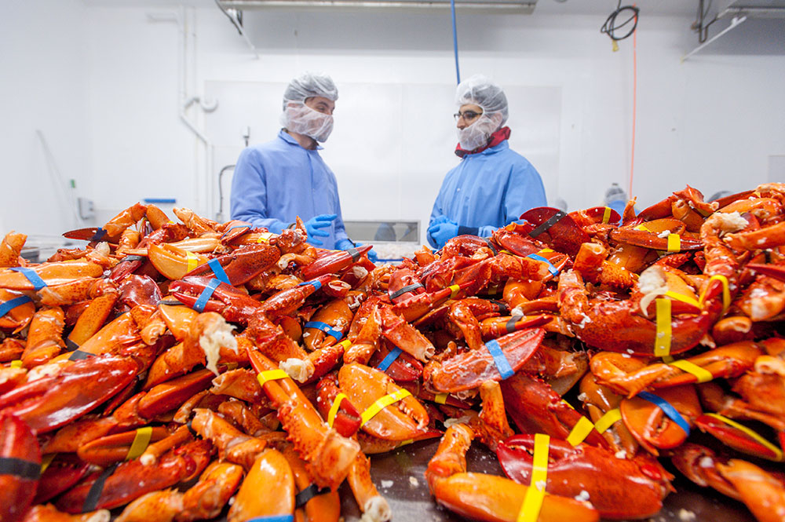
Seafood Processors – Insight from Jason Bolton
We worked with over 20 seafood companies to provide processed authority services to over 30 products for the safe production of over 20,000,000 pounds, with an estimated value of over $130 million.

Slide 26

Seafood Processors: Peeking Behind the Curtain
Keep accurate records
  Google Docs to track client contacts
The phone still works
  Processors are called to acquire the data needed to estimate impact
Use established values and formulas when possible
  a. LBs of seafood = estimated value

Slide 27
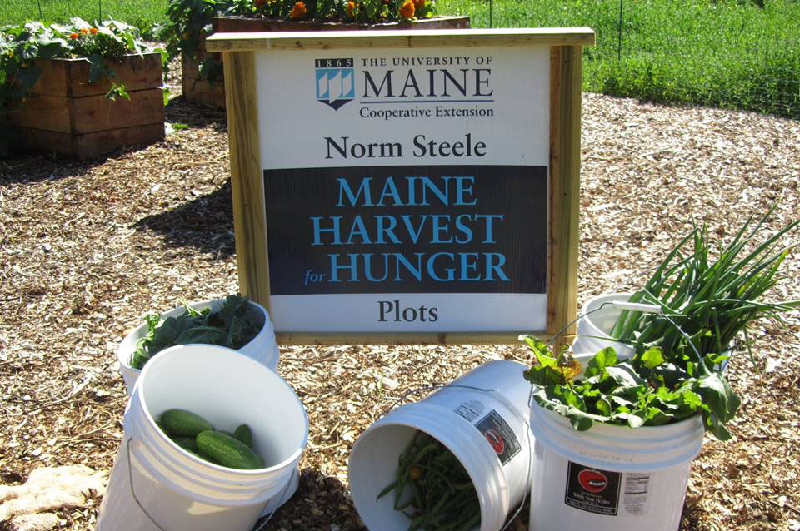
Maine Harvest for Hunger – Insights from Pamela Hargest and the MHH Team
In 2021, 424 MHH volunteers grew, gleaned, and distributed 168,304 lbs of fresh produce, valued at $284,434, to 228 food security agencies located throughout the state.
Photo Credit: The University of Maine

Slide 28
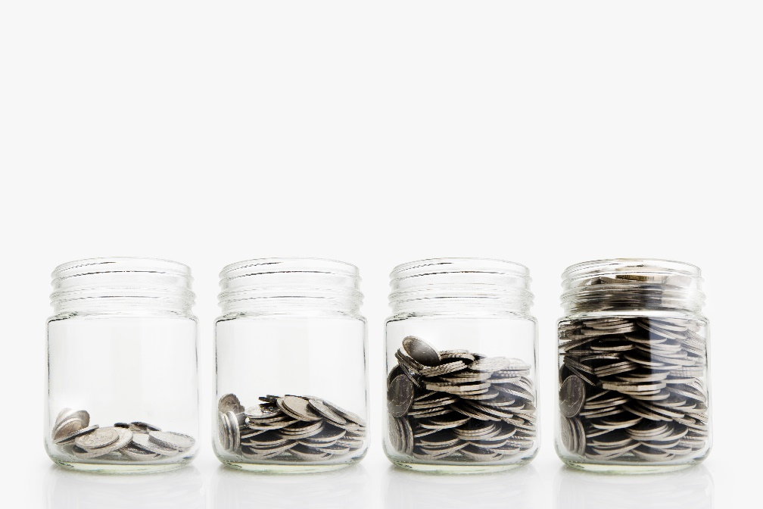
Maine Harvest for Hunger – Peaking Behind the Curtain
Designate a key contact for aggregating data
  Volunteer participation forms are sent to one designated individual
  Data about pounds of produce grown and distributed are aggregated by one individual designated by the Home Horticulture team
Use established values whenever possible to estimate economic impact
  USDA values are used to calculate the total worth of the produce harvested and distributed

Slide 29
Recap: Main Points
Systematically approach evaluation for the best results
Evaluation requires more effort the higher up the hierarchy you go; consider carefully what data to collect and why you need it
Simplify whenever possible
Work with others to amplify the story of your programmatic impact
Questions?

