Slide 1
Extension Connections
With your host – Hannah Carter November 9, 2020

Slide 2
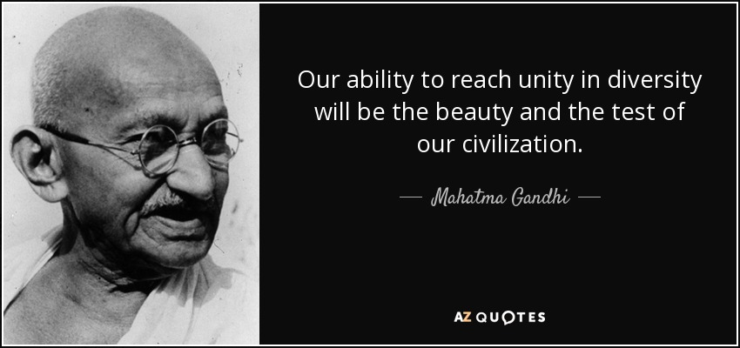
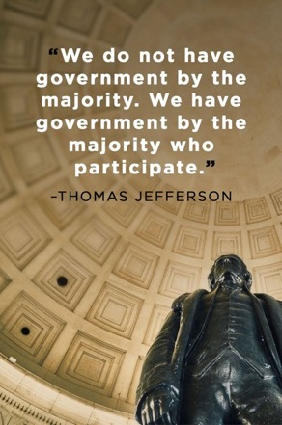

Election Day 2020

Slide 3

Welcome to Extension
On a personal note
COVID updates
Reminders and Follow ups
Survey
DEI work
Recap of October
November
The Future

Slide 4

Welcome to Extension! (We hope you came back for week 2!)
Brian Erickson is starting as the Agricultural Professional in Somerset County
Alexander Bosse is the new EFNEP Supervisory and Youth Curriculum Coordinator (professional) in Androscoggin/Sagadahoc
Tom Mullin is the new 4-H STEM Ambassador (professional) in Androscoggin/Sagadahoc
Hannah Pennington is the new Parent Education Professional in Knox/Lincoln

Slide 5
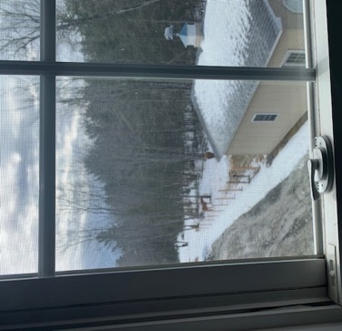
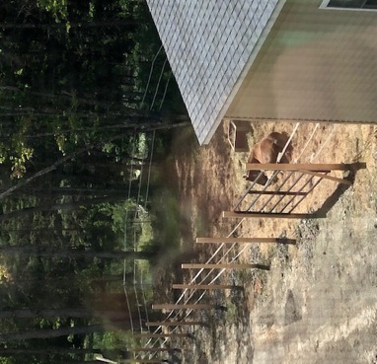
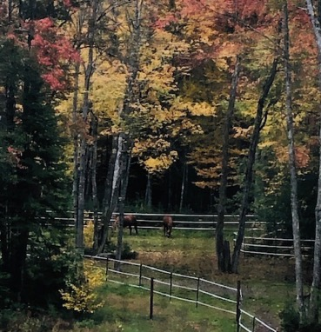
The view out my office window…

Slide 6

Only two months left of 2020!

Slide 7

Now 8 months of living under the COVID umbrella…it’s been a long haul!
Self-care
Exercise
Mindfulness
Safely socializing
Engaging in hobbies
Who is your support network?
Healthy habits
Remember screen time! (20/20/20)
Set boundaries
Expectations
Time
“No.” is a complete sentence
Small joys and comforts
Remember it’s ok to take an afternoon/day/time off!

Slide 8
What do we know in regard to COVID?
Every day there are new situations/issues
UMaine
Counties have changed to yellow/had spikes in numbers
Work with UMaine EOC
Amplified testing for staff
Strictly follow HOCs and guidelines
Offices and programs not going 100% virtual
Students throughout the UMS will be sent home at Thanksgiving
Offices are not going 100% virtual, *HOCs still stand, work continuing as it has been since the end of August
*Fran sent out a short survey on Friday regarding HOCs—please complete it!
Maine CDC recommendations are changing
UMS guidelines may change, some are still more conservative than Maine’s guidelines
Remember grace and flexibility!

Slide 9
Testing and Travel
Testing
Random testing is still occurring
Mandatory
Test kits at every office
Cannot go to a local UMS campus
Can come to UMaine
Thank you to our testing monitors!
Amplified testing
When counties increase numbers/change status
Work with UMaine EOC – Chancellor approves
Same test that is used in random testing (test kits at the offices)
Travel
No out of state business travel
No riding in vehicles with people
Continue to use the travel form
As of November 1:
VT, NH, Mass still exempt from travel restrictions
CT, NY, NJ no longer exempt
UMS COVID Dashboard: https://www.maine.edu/together/

Slide 10
Reminders & Follow ups:
Spending restrictions remain in place
Close scrutiny of purchase using E&G funds, less with gift accounts and grant funds
pcards have been reactivated with lower limits
Utilize marketplace if possible!
Dennis is happy to answer questions
Visiting other offices/facilities
Theme area committees will be announced this week by email
Planning and reporting by November 13th (my goal is 100%!)
Please update your profile on the staff directory
“Add Pay” for on-line programming should have been in October paychecks

Slide 11
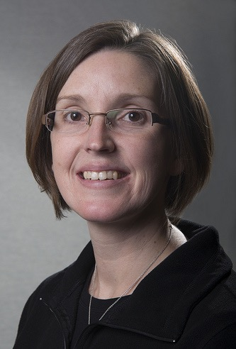
And the survey says….
UMaine Extension Readiness for Virtual Programming Survey

Slide 12
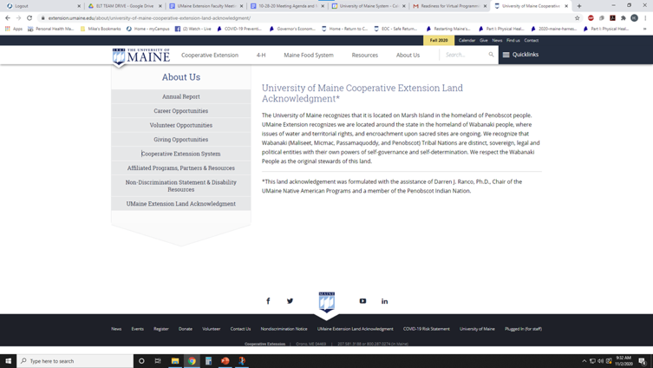
Diversity, Equity and Inclusion Work Continues
Book cohorts are over half-way done
President’s Council on DEI
Report due in December
Land acknowledgment
What are our next steps?

Slide 13
Looking back at October…
Increase in COVID numbers
Provost visit to Aroostook County
President Ferrini-Mundy’s Seaman Knapp Lecture
President’s Council on DEI
Book discussions
KPI group
ERC
Budget Forum
4-H Foundation Board Meeting
Deferred students
Internships
Extension Roadmap
Maine Calling

Slide 14

What’s ahead in November
ERC recommendations
Dean Searches
President’s Council for DEI
International Leadership Association annual meeting
Reception for our newly promoted faculty
APLU annual meeting
Managing COVID
Continuing to think about how Extension administration evolves
Being thankful

Slide 15
Beyond 2020--thinking towards the future…
What does 2021 look like in regard to continuing to work under the umbrella of COVID?
Extension Roadmap
Committees and leaders will begin their work this week
Initial reports due end of Jan/early Feb – shared during our “All Organization” meeting on March 16th-18th (virtually)
Other initiatives
Brightspace – Learning management system (LMS)
Committee working on how to create online programming utilizing Brightspace
SalesForce – Customer relationship management (CRM)
Exploration phase with small working group
Internships – connections to students
Committee working on how to build these opportunities
Fundraising/philanthropy – endowed positions and programs

Slide 16
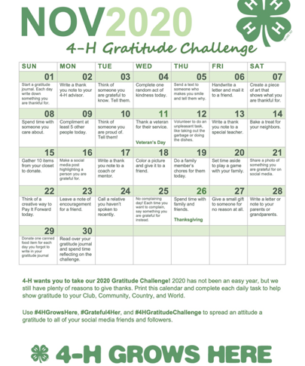
Questions?

