Slide 1
Extension Connections
With your host – Hannah Carter
October 5, 2020
National 4-H Week!

Slide 2
Today
National 4-H Week
FYIs
COVID updates
Reporting
September
October
Organizational Survey and Changes
Notes:
Thankful to be leading Extension

Slide 3

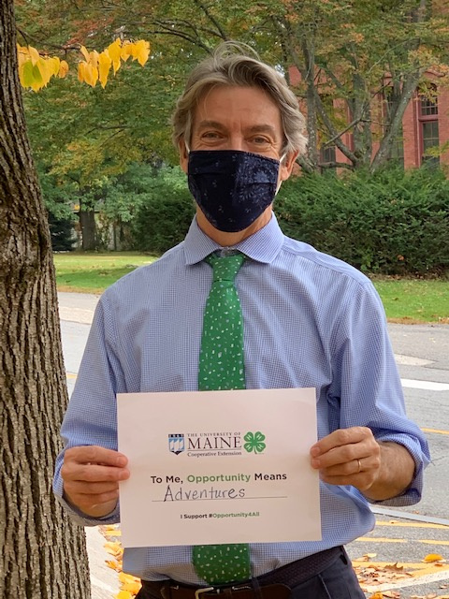
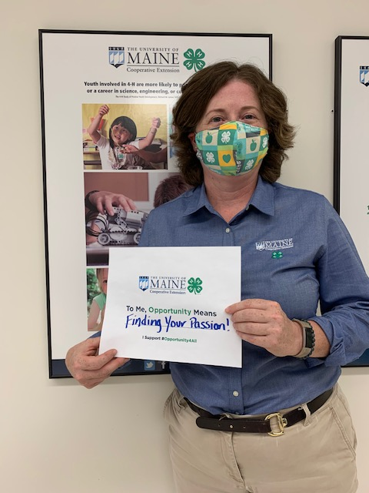
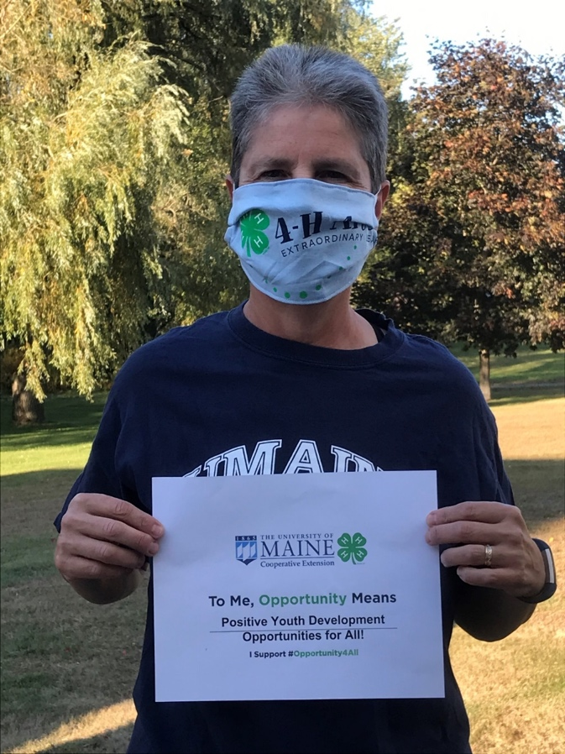
Notes:
In 2019:
Over 16,000 youth participated in the Maine 4-H program
Over 1,500 volunteers provided positive learning experiences
In August, UMaine partnered with two other northern New England land grant institutions (UNH and UVM) to submit a proposal to USDA's competitive "Agriculture and Food Research Initiative" (AFRI) program. With UNH as the lead, the three LGUs formed the "Northeast Collaborative" and submitted a $680,000 proposal to AFRI on August 22. The project, titled Northeast 4-H Collaborative: Closing the Gap, proposed to utilize the existing community-based faculty and staff resources of Cooperative Extension's 4-H Youth Development Program to develop and deliver a creative K-12 remote learning model for STEM and Agricultural Sciences.
The Northeast Collaborative team was informed last week that the proposal was funded. UMaine will accept a $328,191 sub-award over the next two years ($260,469 direct; $67,722 indirect). Cooperative Extension's 4-H Center team will play a leading role in program delivery, serving rural, under-resourced K-12 classrooms across the three-state region.

Slide 4
FYIs
There’s still time to join a book discussion!
$500 “add pay” for online programming
New PARS system
Grant assistance through ORD

Slide 5
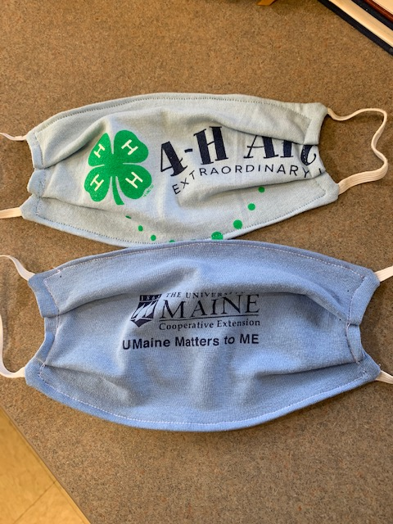
COVID-19 Photo Protocols:
For photos, all Extension materials created for the public and/or our volunteers need to comply with the current photo guidelines. If it's impossible to source photos that show people with masks, this disclaimer is used:
Photographs of people not wearing masks were taken prior to the coronavirus pandemic. The University of Maine and University of Maine at Machias follow federal and state Centers for Disease Control and Prevention health and safety guidance, which currently includes social distancing and use of face coverings.
Photos of youth and adults, even when alone and/or outdoors, should show individuals masked, per Margaret Nagle (UMaine Communications).
The language in the disclaimer can be revised to say 'The University of Maine and..., including UMaine Extension, follow federal...' if you think that works better for viewers.
There will be a folder “COVID appropriate photos” (in Master Media)
Plugged In has been updated, “Photos and Copyright: What You Need to Know”
Please reach out to the Communications & Marketing Team with any questions!

Slide 6
Other COVID updates:
Programs
Virtual for larger programs
Increased size of youth programs
Testing
Phase 3 testing
Amplified testing
Offices going to all remote
York continues to be working remotely
Other offices are being monitored
Still limited in regards to travel
Still in a spending freeze
Still in a very limited hiring process

Slide 7
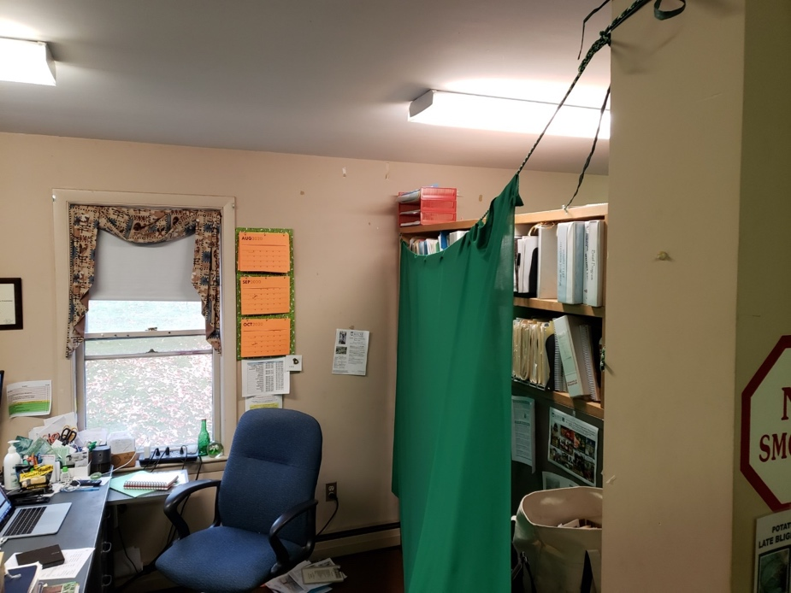
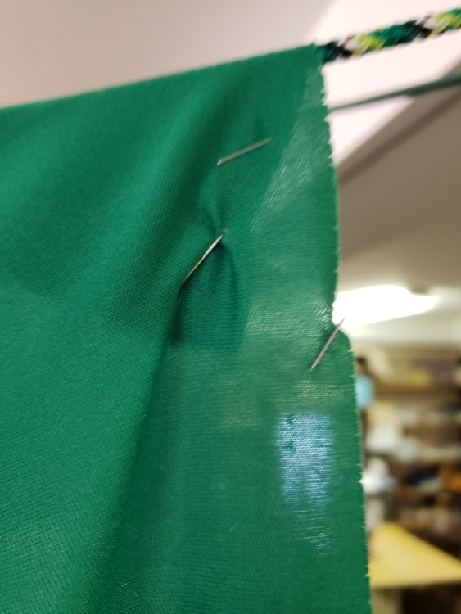
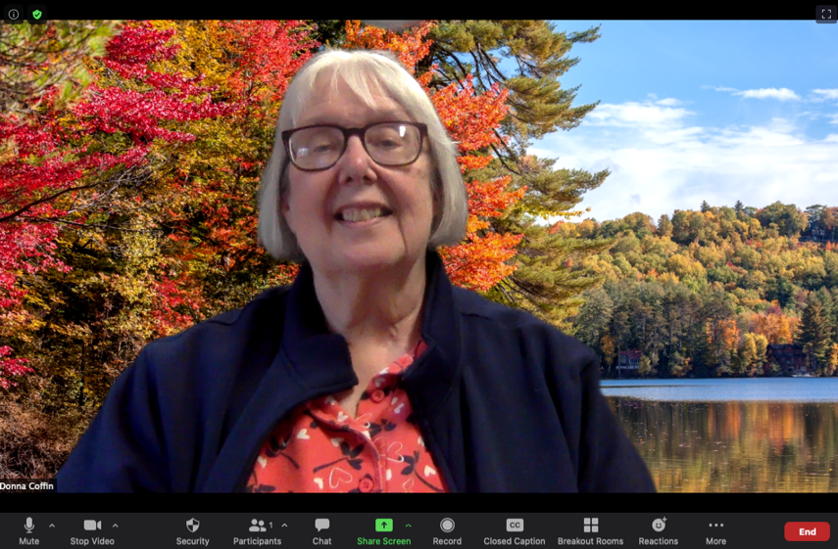
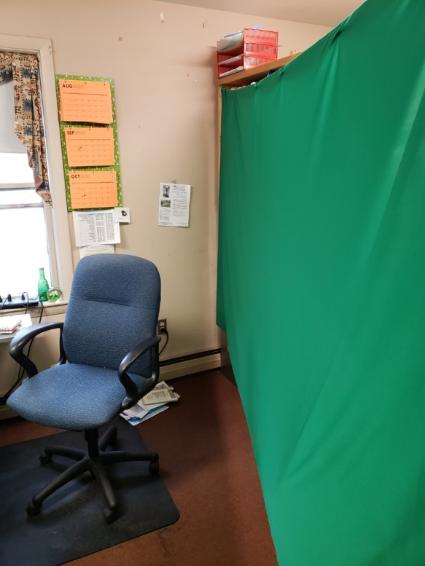
Green Screen DIY
6 yards of green jersey knit type fabric from JoAnn.
Possibly use 1-1/2 yards per office.
Cost was $2.80/yard, they were having a sale.
Rope and a stapler (sewers could sew a channel for the rope)
Remember to raise your camera to eye level.
Secure the rope between two points behind you. A post or hanger on the wall or bookcase. You need to be at least 4 feet or less to the cloth.
Place the cloth over the top of the rope and secure with staples.
You are ready to use a virtual background.
Thank you Donna Coffin!

Slide 8
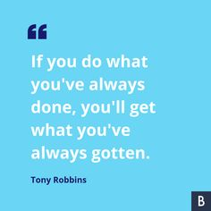
Annual MPRS Reporting
November 13th deadline!
FY20 (October 1, 2019 to September 30, 2020)
Cannot stress how important this is—especially this year!
PLEASE enter at least one quality impact statement that follows the 3 paragraph format (relevance, response and results)
Did I mention how important reporting is?? It will be both critical and crucial in telling our story and our need for increased resources.

Slide 9
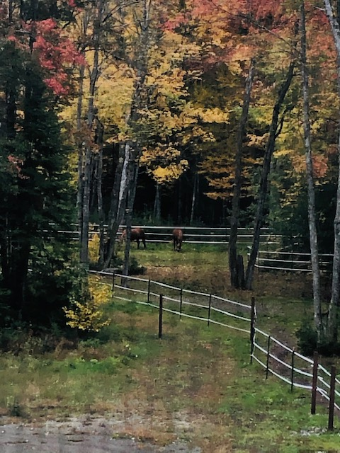
September
We last met on September 14th
National Meetings
Journal of Extension
National Extension Directors
Northeast Extension Directors
Economic Recovery Committee
Innovation & Entrepreneurship Subcommittee
FOR/Maine
Small Woodlot Owners
UMaine
Curtailment
FY21 budget

Slide 10
October
“Earlier in my life I thought the things that mattered were the things that you could see, like your car, your house, your wealth, your property, your office. But as I’ve grown older I’ve become convinced that the things that matter most are the things that you can’t see—the love you share with others, your inner purpose, your comfort with who you are.”
-Former President Jimmy Carter, who turned 96 on Oct. 1st
Monitor our HOCs and guidelines
Maine Hunger Dialogue
Committee meets on Extension Internships (Externships)
Provost Tour – Aroostook County
Increasing # of university meetings
Deferred students
Key Performance Indicators (KPIs)
Dean Searches
President’s Council on DEI

Slide 11
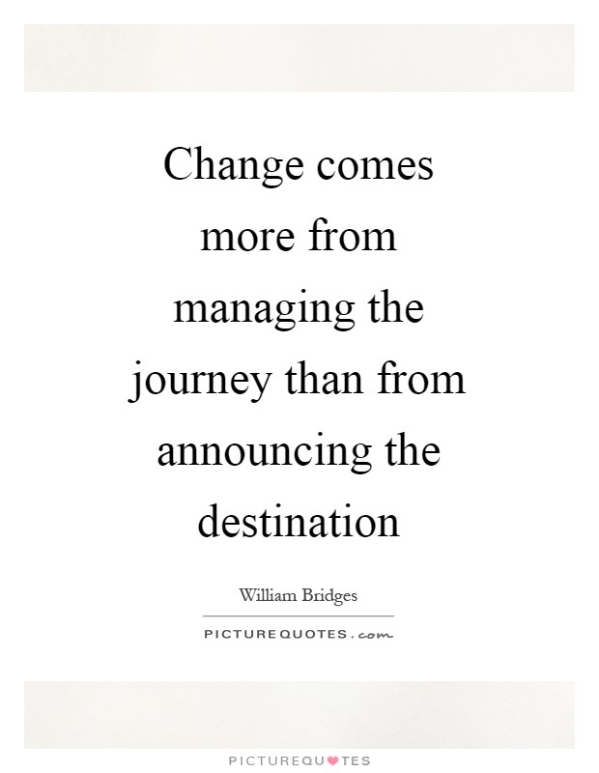
Looking Forward….
My perspective on organizational change
Inclusive process—this isn’t “my” organization, it’s “our” organization.
We are a different organization then when I even arrived 17 months ago
We need to represent everyone
By no means am I critical of previous leaders, they had different priorities and led Extension at different times
One of the reasons I was hired was to make changes, to help Extension think about the future and to “not do things the way they’ve always been done”.

Slide 12
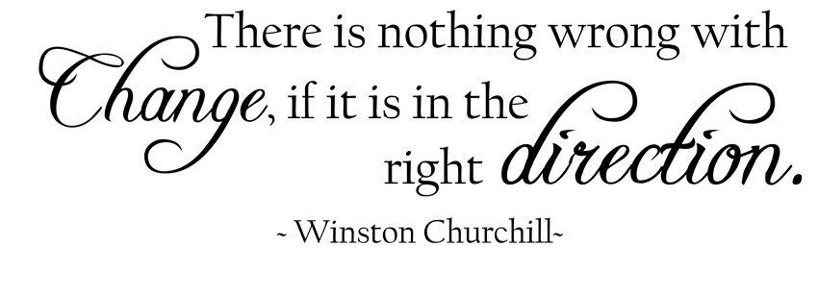
So what does this mean?
My “purview” (scope of influence)
The team that I have around me who exemplifies:
Trust
Responsibility
Transparency
New ways of thinking
Growth mindset
Leadership
Vision
Ability to inspire others
Communication
Our “purview”
What is our “why”? (November 2019)
How do we accomplish our “why”?
The future
on-line programming
Revenue generation
Collaboration
Identifying our program areas and working collaboratively across both these areas and county boundaries
Communications & Marketing Extension
Internal Operations (How we work?)
Share staff; greater Extension/Campus connections; regional teams
Policy around working remotely?
County coordination

Slide 13
Next Steps….
Formalize 5 working groups
Each working group will have a chair/leader
Ask for volunteers to serve as chair/leaders and as members
Working groups will meet from October – January
They can collect additional data through surveys, focus groups, etc.
My new administrative team will be in place in December
February – final reports/recommendations will be due to me
UMaine Virtual All Staff Conference March 16th-18th
May have an outside facilitator lead the discussion of the future
Working groups will have a chance to share their recommendations with the whole organization
Participants will provide feedback and recommendations

Slide 14

And then we implement…

Slide 15
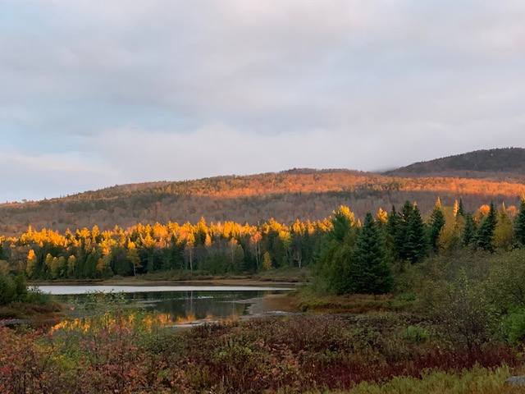
See you on November 2nd
“Leadership is not about being in charge.
Leadership is about taking care of those in your charge.” -Simon Sinek

