Slide 1
Extension Connections
With your host – Hannah Carter August 2, 2021

Slide 2
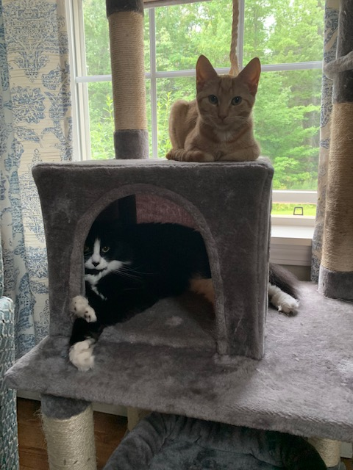
Today’s agenda
Welcome to Extension
COVID updates
Cluster Hire
July & August
Reminders
Publications transition

Slide 3
Welcome to Extension!
Christine Gettig – Administrative Specialist CL2 in Somerset County
Eri Martin – Program Coordinator Bryant Pond and Greenland Point 4-H Centers
Mara Scallon – Research Assistant, Lowbush Blueberry Research & Extension Program
Ellen Baker – Parent Education Professional, Maine Families Program
Dr. Matt Hawkyard – Assistant Extension Professor & Fish Nutrition Specialist
Dr. H-Michael Habte-Tsion – Assistant Extension Professor & Fish Nutrition Specialist

Slide 4
Remote Work Guidance
The latest UMS guidance regarding remote work, including remote work guidelines and a decision tree document, is now available. Employees who have been working remotely are encouraged to discuss questions and arrangements related to returning to campus work locations with their managers or supervisors. Remote work arrangements must be approved by the respective management team and documented using the online Remote Work Agreement tool.
Requests for remote work in Extension (which is a part of UMaine Academic Affairs) should go to your supervisor. If that person is in favor of granting the request, it should go to me (the dean), and then to the provost if the dean agrees. The final decision on remote work requests will be made by Provost Volin. Declinations do not need to go up the chain.
Our offices need to be open during regular business hours, five days a week unless previously approved to have a different schedule (ie Piscataquis County)
If you had an approved remote work arrangement prior to the pandemic, please submit the new form as there have been updates made.
I have asked that everyone who believes they want to seek permission to have some sort of remote work agreement submit this form—I would like a unified approach within Extension.

Slide 5
Other COVID updates (or things to mention):
UMS/UMaine following state guidelines
Face masks: In general, face coverings will continue to be welcomed in any circumstance when individuals choose to wear them as a matter of personal preference. There may be certain exceptions related to security-sensitive circumstances or other matters when they must be removed. Effective July 26, face coverings will continue to be required indoors for any visitor, faculty, staff, or student who is not fully vaccinated.
Vaccinations
Building/conference room use – as of August 2nd the UMS “will return to customary, pre-pandemic operations”.
Testing: Yes, for unvaccinated individuals. Weekly testing will be required this fall for unvaccinated students, staff and faculty in the university’s in-person community. Vaccinated persons are currently exempt. Testing also is available for vaccinated persons upon request. The weekly ​​testing is available for asymptomatic community members. People who are symptomatic should seek medical attention from the primary care provider or campus health center.

Slide 6
Cluster Hires
What is a Cluster Hire?
Carla Freeman, in an article for The Chronicle of Higher Education, says that this process can take many forms, but the main goal and structure are simple: “Prioritize and invest in multiple positions in a broad field, or across a range of related fields, rather than hiring faculty members one by one in specific subfields. This increases the likelihood of a diverse pool of candidates, identifies synergistic connections among candidates and, by recruiting faculty cohorts together, fosters collaboration and a shared experience.” https://hrdailyadvisor.blr.com/2020/02 /06/what-is-cluster-hiring/
An update on the Cluster Hire Proposals--the deadline has been extended to September 7th and I wanted to provide some clarification. My intention is to approve all completed proposals that involve Extension (Please be aware that “approval” in this instance means “approval to enter the competition".) For this first-time call, we can’t know in advance how many proposals will be submitted across the University or how they will compete with one another. Given that, it’s good for Extension to be party to multiple credible proposals so as to increase the chances of selection for Extension as a whole. A vetting process to eliminate proposals at this level wouldn’t be wise, though I do need to review. So:
Please send complete drafts for my review to hcarter@maine.edu by the close of business on August 23rd. It’s fine for you to revise after this. Just bring any major changes to my attention.
I will email my reply by the morning of August 30th so that you can include it with your submission.
I welcome the opportunity to advise as proposals are being developed. I have already had several really interesting conversations about cluster hire ideas.

Slide 7
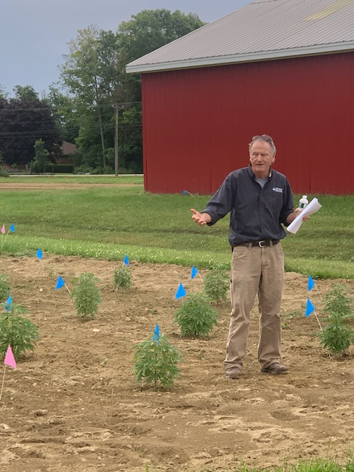
Last Month & This Month
July
August
More in person meetings and events
4-H Summer Learning Leadership Series kicked off!
Maine Potato Board Dinner
Provost visit to Bryant Pond
Dairy candidate visit
Took a little break
Communications position moving forward
COVID, COVID, COVID
COVID, COVID, COVID
More in person events
Internship program transition
ELT changes
Deans Retreat
Taking a couple of additional days off

Slide 8
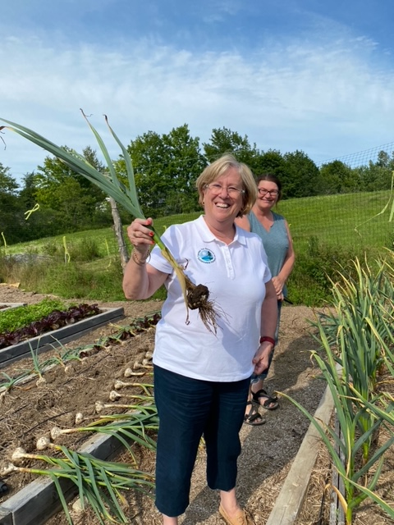
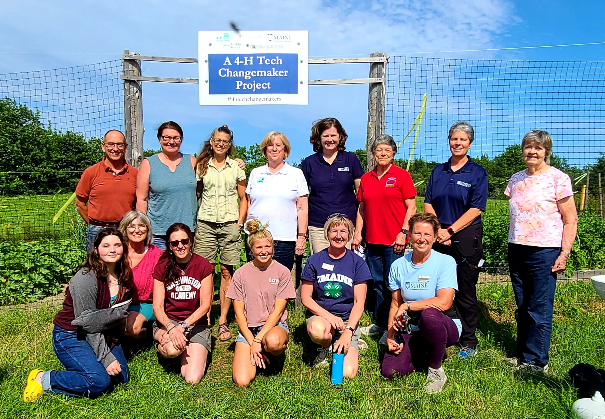
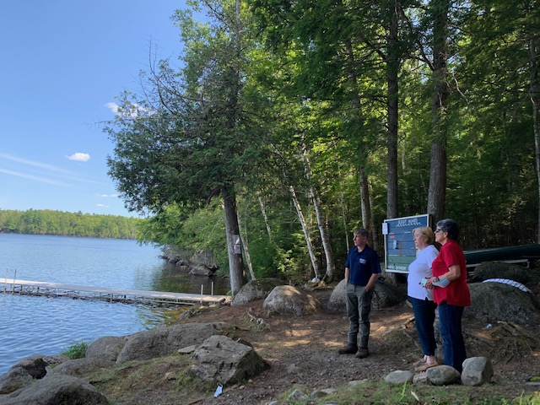
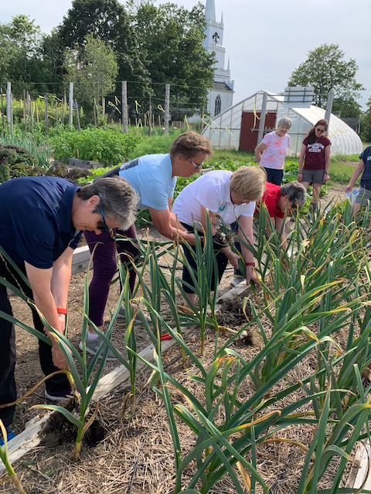
WA County Tour with the President

Slide 9
Reminders
Lunch and Learn on August 20th at 11:30 a.m.
The Roadmap Steering Committee met on 7/27, minutes of the meeting will be posted on the Roadmap website in the next week.
Grace and flexibility—think we may need them more then we ever have before!

Slide 10
Publications Transition
Upcoming changes to UMaine Extension’s publication catalog:
Starting August 1, 2021 there will be a new online publication catalog. The current platform for Extension’s online publication catalog will no longer be available. The new publication catalog can be found here: https://extension.umaine.edu/publications/
The catalog only includes UMaine Extension’s digital publications. Sales of hardcover books and non-digital publications will be (temporarily) suspended, although staff can purchase existing inventory (with university chartfields) by contacting Tracey Ferwerda.
Online sales for pesticide educational resources can be found in the new UMaine Cooperative Extension Marketplace: https://secure.touchnet.com/C22921_ustores/web/store_main.jsp?STOREID=33&SINGLESTORE=true
Questions can be directed to Tracey Ferwerda tracey.ferwerda@maine.edu

